Slide 1
Section 2
Networks and graphs

Slide 2
COMPONENTS OF A COMPLEX SYSTEM
components: nodes, vertices N
interactions: links, edges L
system: network, graph (N,L)
Network Science: Graph Theory

Slide 3
NETWORKS OR GRAPHS?
network often refers to real systems
www,
social network
metabolic network.
Language: (Network, node, link)
graph: mathematical representation of a network
web graph,
social graph (a Facebook term)
Language: (Graph, vertex, edge)
We will try to make this distinction whenever it is appropriate, but in most cases we will use the two terms interchangeably.
Network Science: Graph Theory

Slide 4

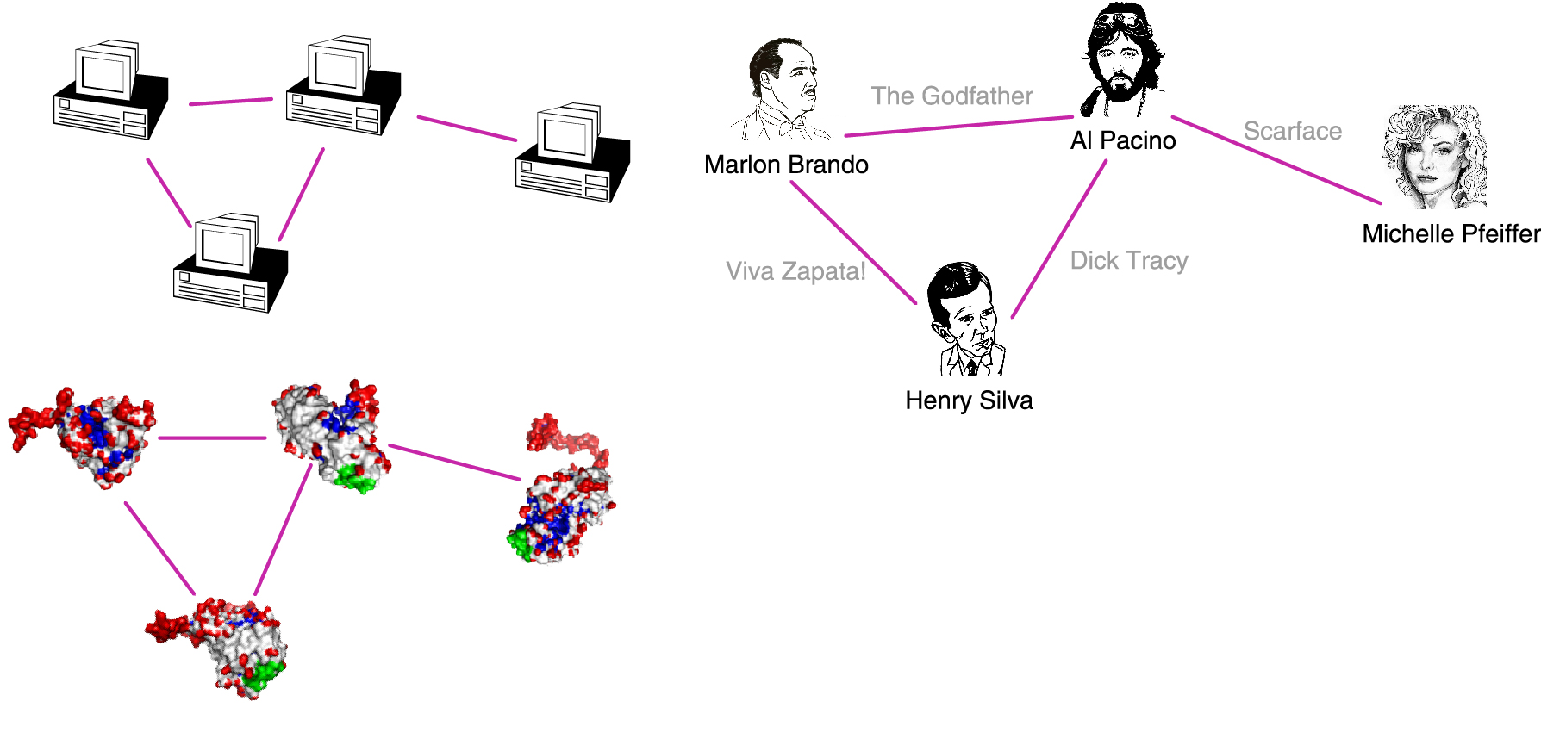
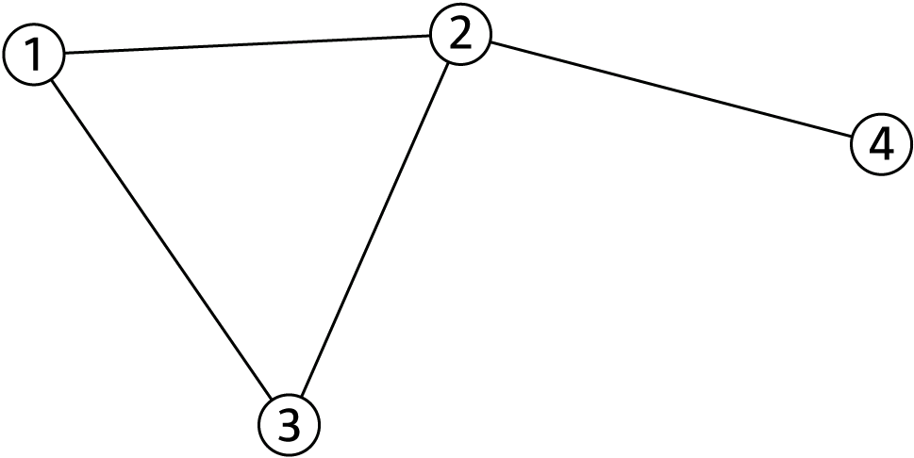
A COMMON LANGUAGE
N=4
L=4
Network Science: Graph Theory

Slide 5
CHOOSING A PROPER REPRESENTATION
The choice of the proper network representation determines our ability to use network theory successfully.
In some cases there is a unique, unambiguous representation.
In other cases, the representation is by no means unique.
For example, the way we assign the links between a group of individuals will determine the nature of the question we can study.
Network Science: Graph Theory

Slide 6
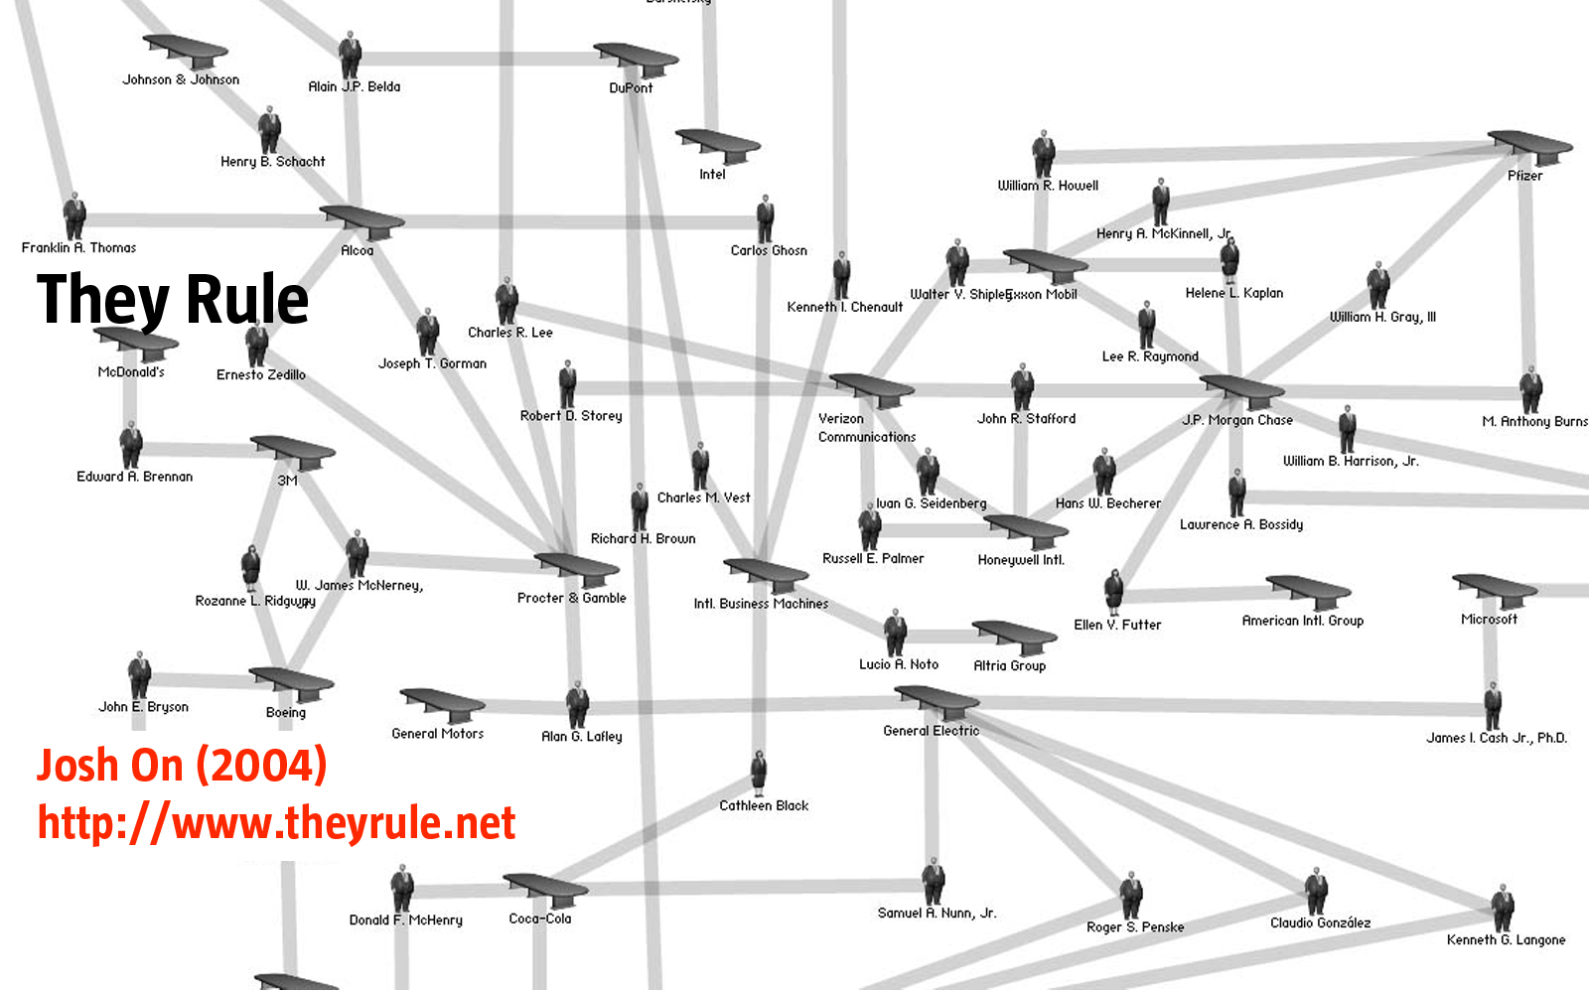
CHOOSING A PROPER REPRESENTATION
If you connect individuals that work with each other, you will explore
the professional network.
Network Science: Graph Theory

Slide 7
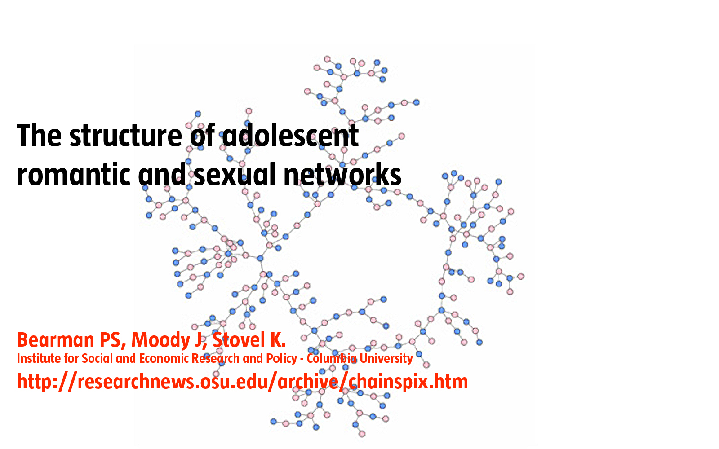
CHOOSING A PROPER REPRESENTATION
If you connect those that have a romantic and sexual relationship, you will be exploring the sexual networks.
Network Science: Graph Theory

Slide 8
CHOOSING A PROPER REPRESENTATION
If you connect individuals based on their first name (all Peters connected to each other), you will be exploring what?
It is a network, nevertheless.
Network Science: Graph Theory

Slide 9
Question 2
Q2: Degree, degree distribution.

Slide 10
Section 2.3
Degree, Average Degree and Degree Distribution

Slide 11
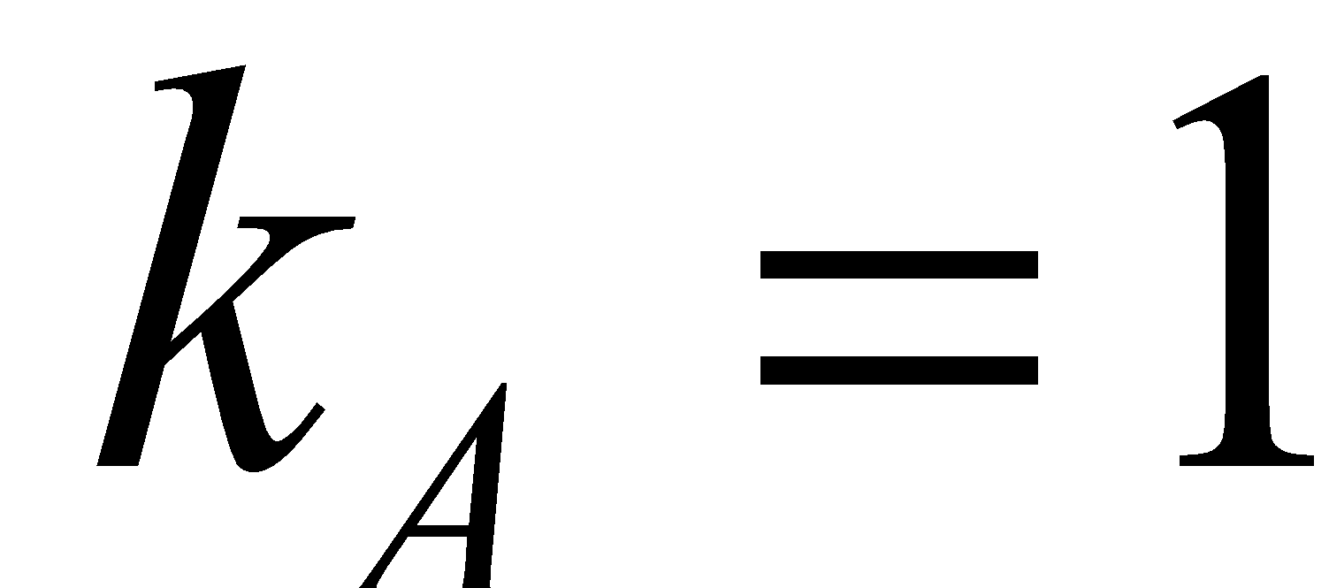
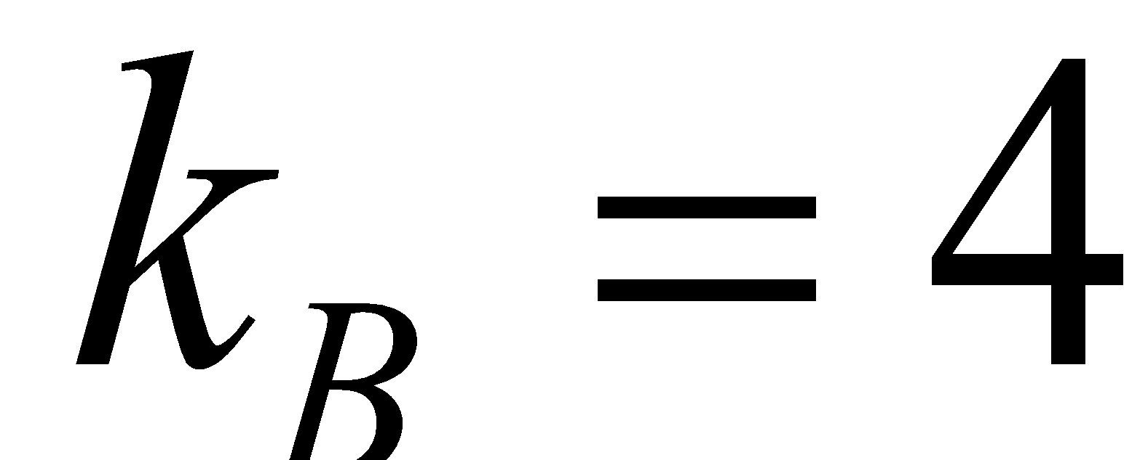
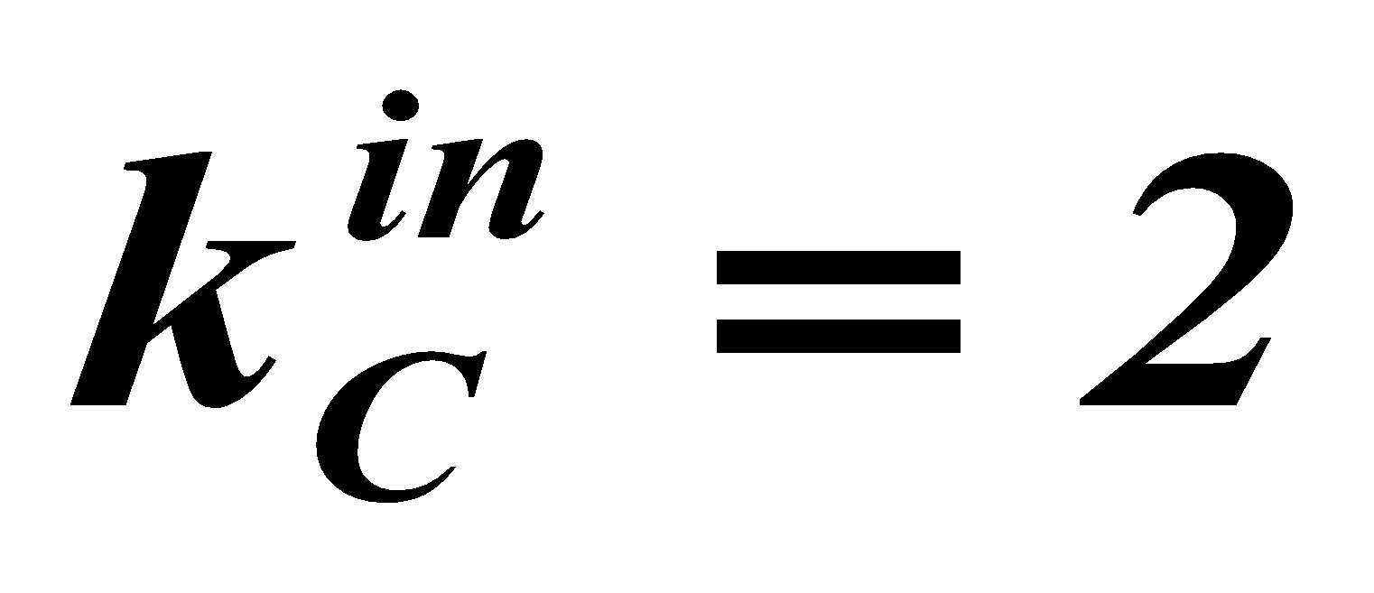
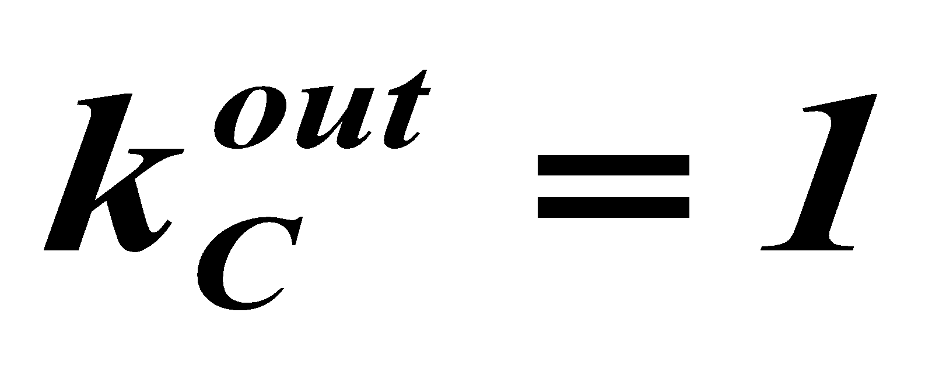
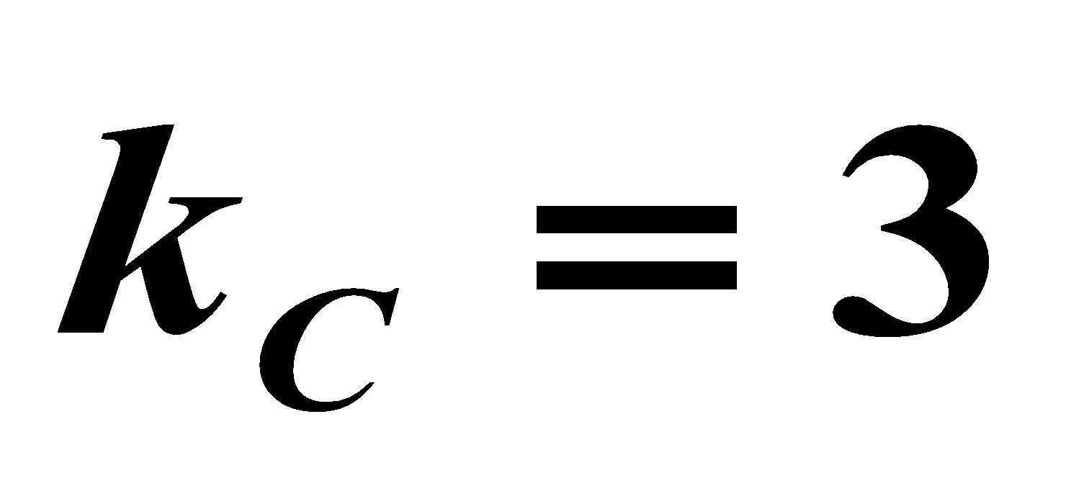
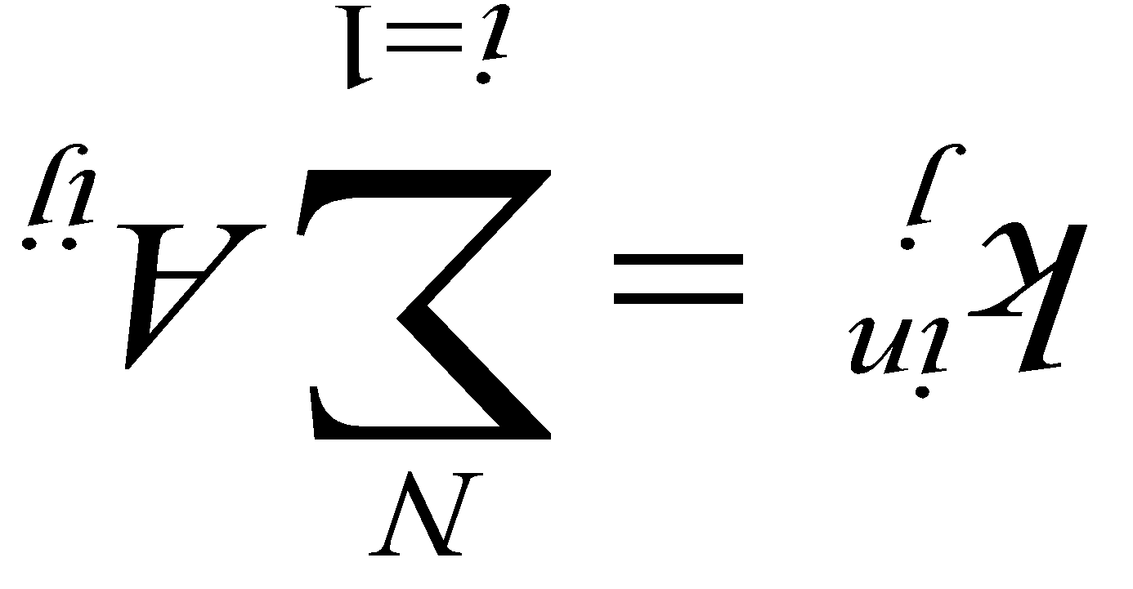
NODE DEGREES
Node degree: the number of links connected to the node.
A
Undirected
B
In directed networks we can define an in-degree and out-degree. The (total) degree is the sum of in- and out-degree.
Source: a node with k^{in}= 0; Sink: a node with k^{out}= 0.
B
D
Directed
C
G
E
A
F
Notes:
A key property of each node is its degree, representing the number of links it has to other nodes. The degree can represent the number of mobile phone contacts an individual has in the call graph (i.e. the number of different indivi uals the person has talked to), or the number of citations a research paper gets in the citation network.
We denote with ki the degree of the ith node in the network.

Slide 12
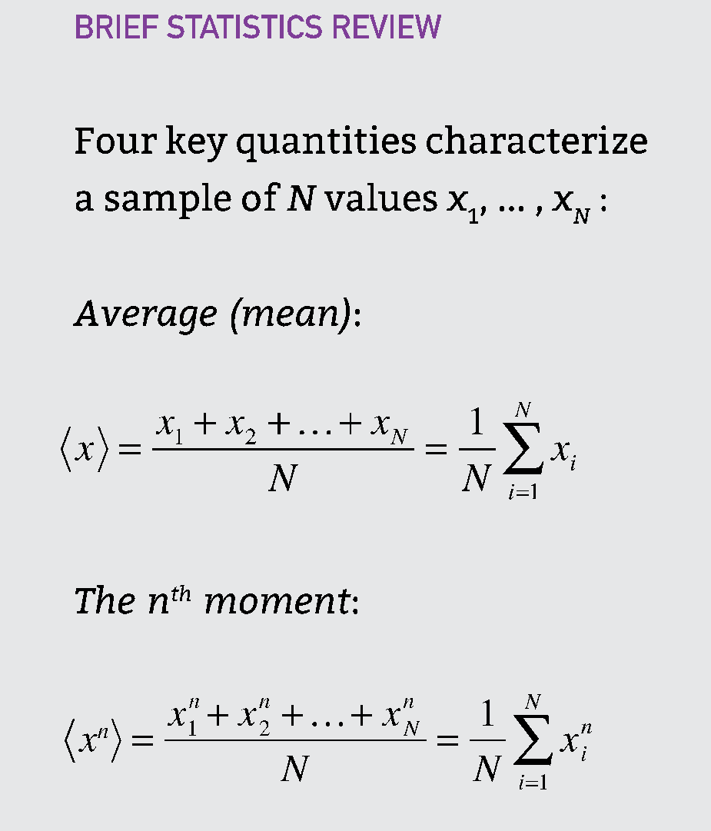
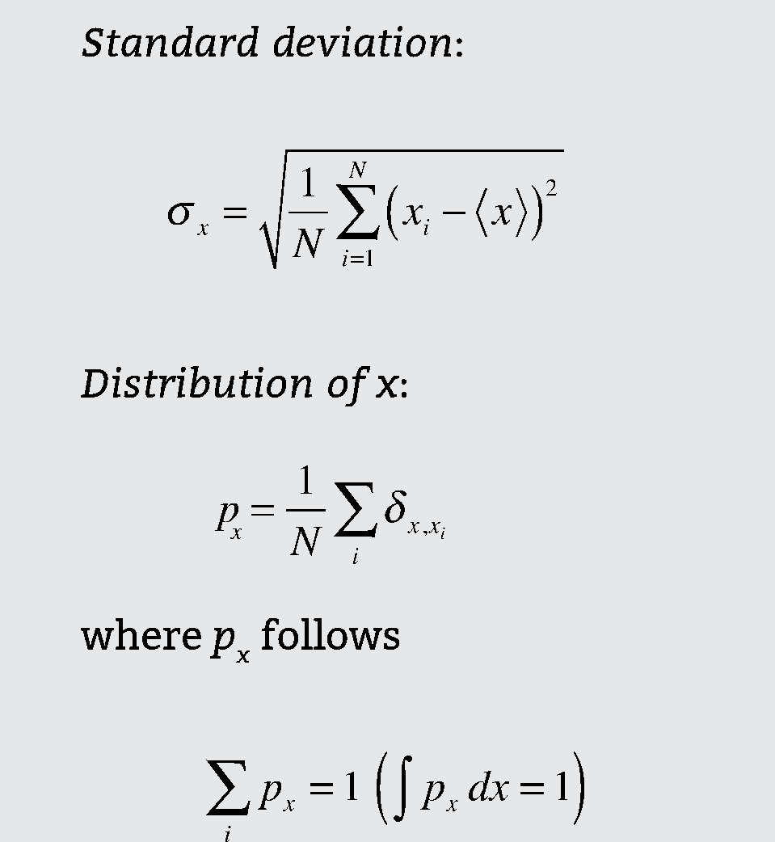
A BIT OF STATISTICS
Network Science: Graph Theory

Slide 13
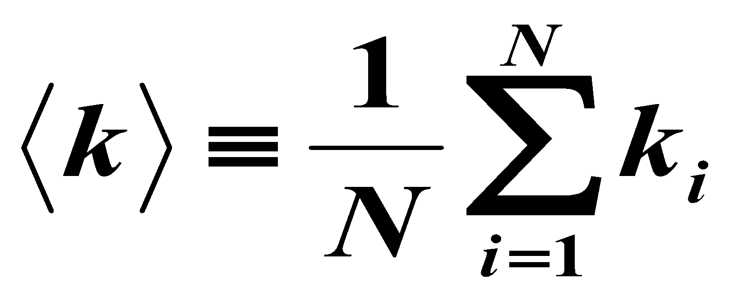
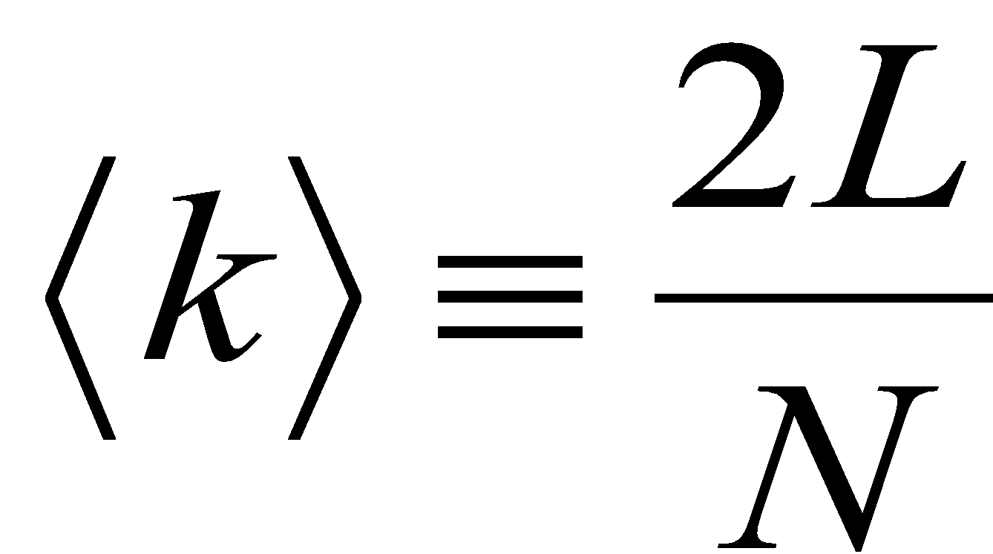
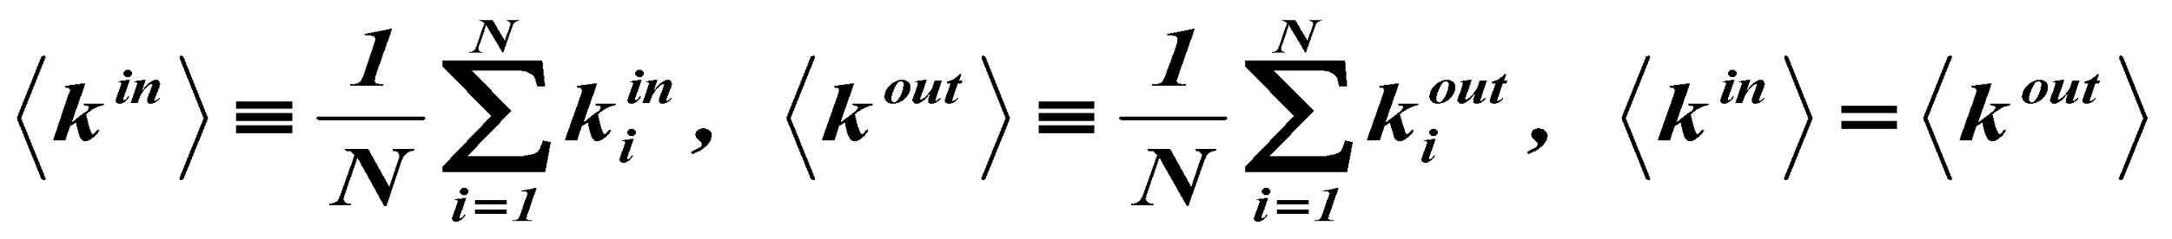
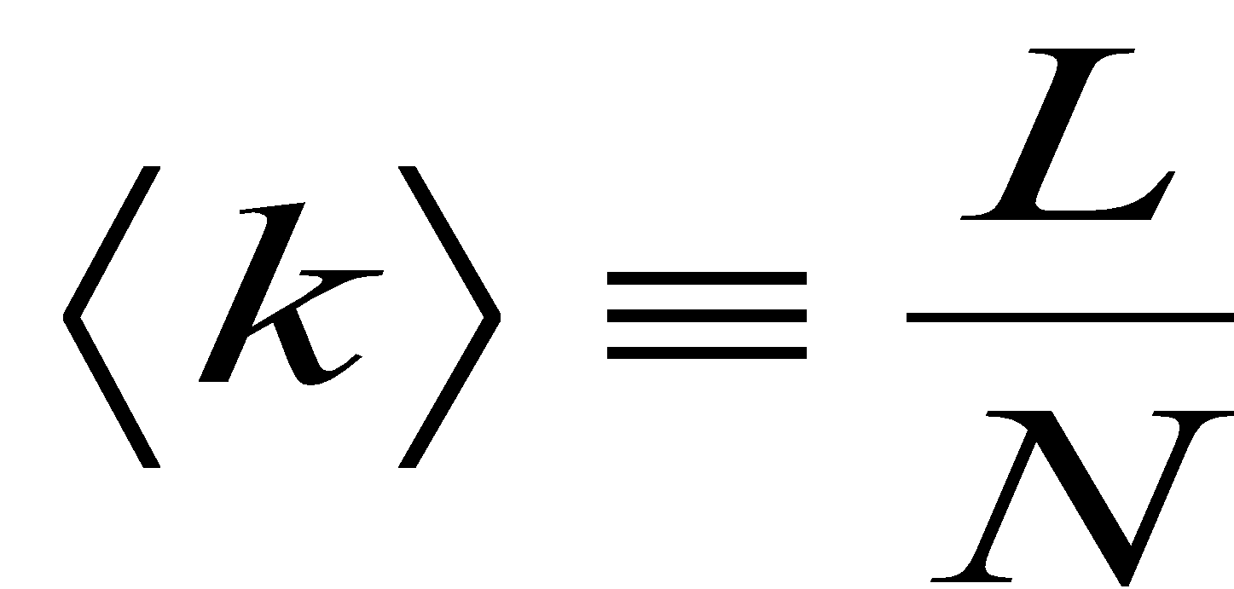
AVERAGE DEGREE
Undirected
j
i
N – the number of nodes in the graph
B
D
Directed
C
E
A
F
Network Science: Graph Theory

Slide 14
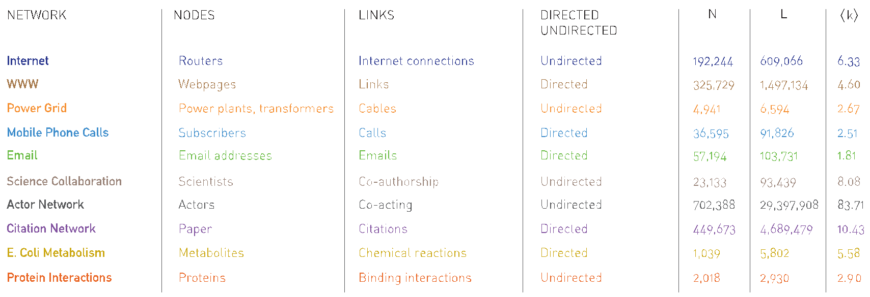
Average Degree
Network Science: Graph Theory

Slide 15
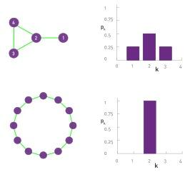
DEGREE DISTRIBUTION
Degree distribution
P(k): probability that a
randomly chosen node
has degree k
N_{k} = # nodes with degree k
P(k) = N_{k} / N ➔ plot

Slide 16
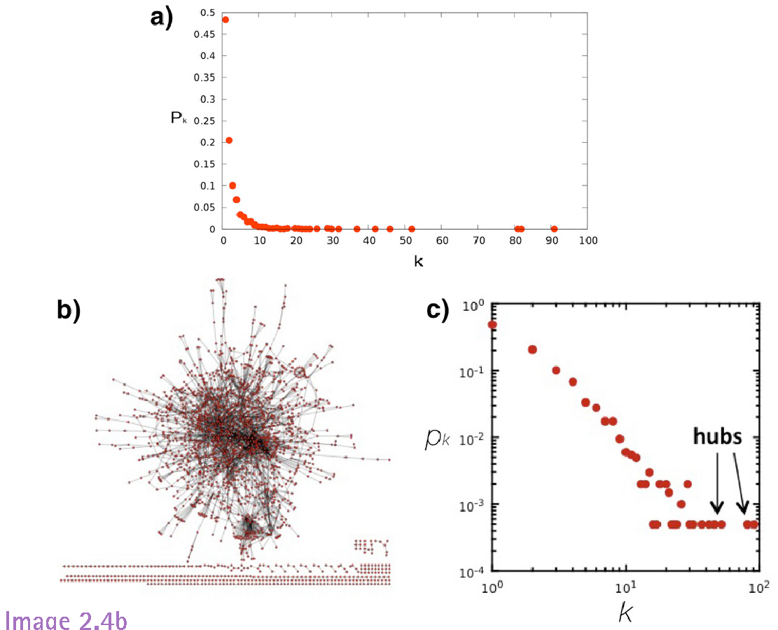
DEGREE DISTRIBUTION
Notes:
In many real networks, the node degree can vary considerably.
For example, as the degree distribution (a) indicates, the degrees of the proteins in the protein interaction network shown in (b) vary between k=0 (isolated nodes) and k=92, which is the degree of the largest node, called a hub. There are also wide differences in the number of nodes with different degrees: as (a) shows, almost half of the nodes have degree one (i.e. p1=0.48), while there is only one copy of the biggest node, hence p92 = 1/ N=0.0005. (c) The degree distribution is often shown on a so-called log- log plot, in which we either plot log pk in function of log k, or, as we did in (c), we use logarithmic axes.

Slide 17
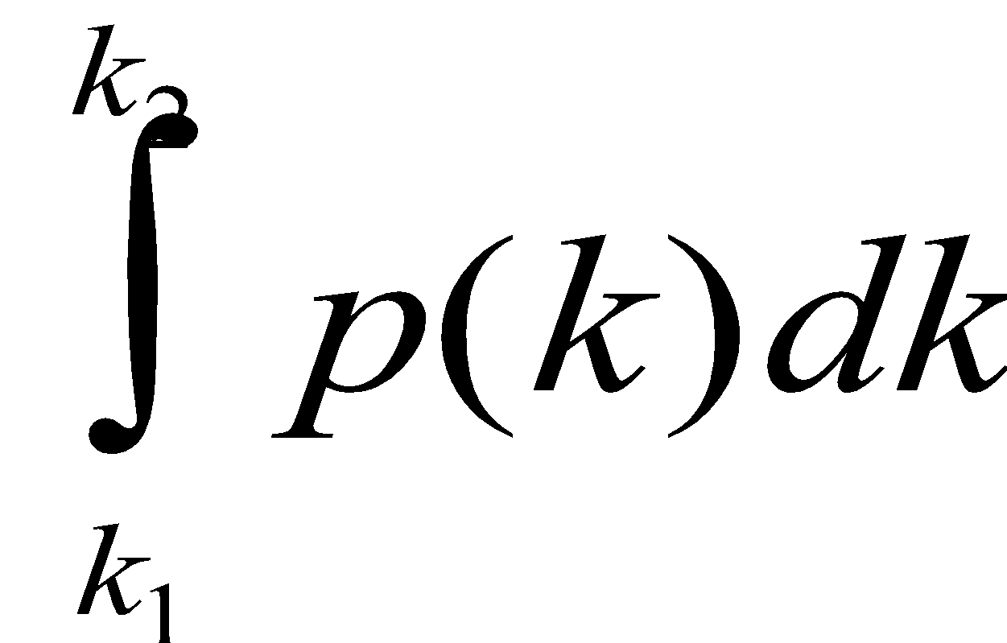
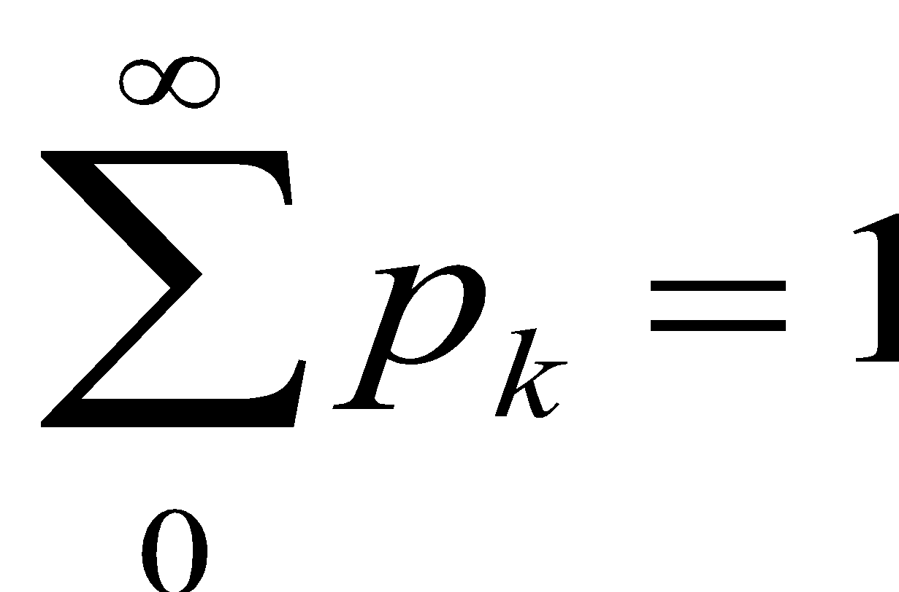
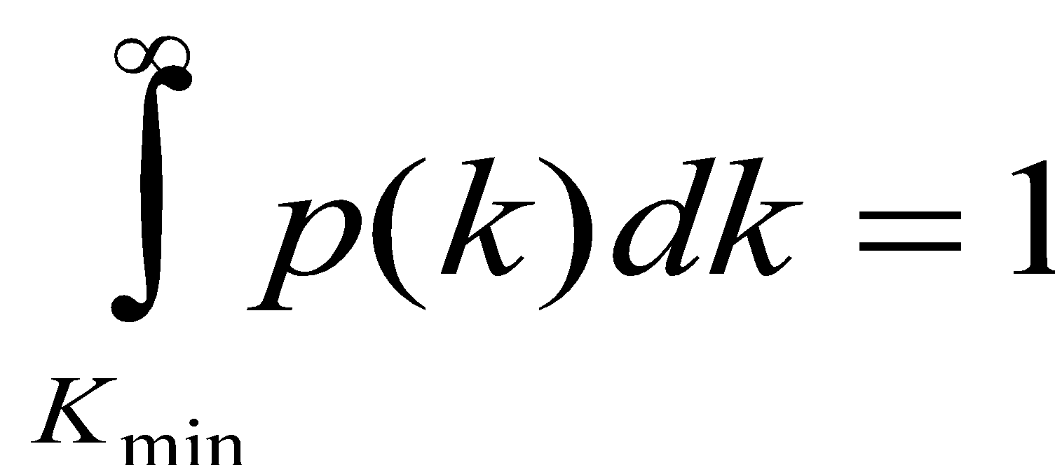
DEGREE DISTRIBUTION
Discrete Representation: p_{k} is the probability that a node has degree k.
Continuum Description: p(k) is the pdf of the degrees, where
represents the probability that a node’s degree is between k₁ and k₂.
Normalization condition:
where K_{min} is the minimal degree in the network.
Network Science: Graph Theory

Slide 18
Question 3
Q3: Directed vs. undirected networks.

Slide 19
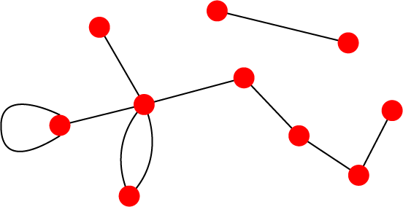
UNDIRECTED VS. DIRECTED NETWORKS
Undirected
Directed
Links: undirected (symmetrical)
Graph:
Links: directed (arcs).
Digraph = directed graph:
L
A
D
F
M
B
An undirected link is the superposition of two opposite directed links.
C
I
D
B
G
E
G
H
A
C
F
Undirected links :
coauthorship links
Actor network
protein interactions
Directed links :
URLs on the www
phone calls
metabolic reactions
Network Science: Graph Theory
Notes:
A key property of each node is its degree, representing the number of links it has to other nodes. The degree can represent the number of mobile phone contacts an individual has in the call graph (i.e. the number of different indivi uals the person has talked to), or the number of citations a research paper gets in the citation network.
We denote with ki the degree of the ith node in the network.

Slide 20
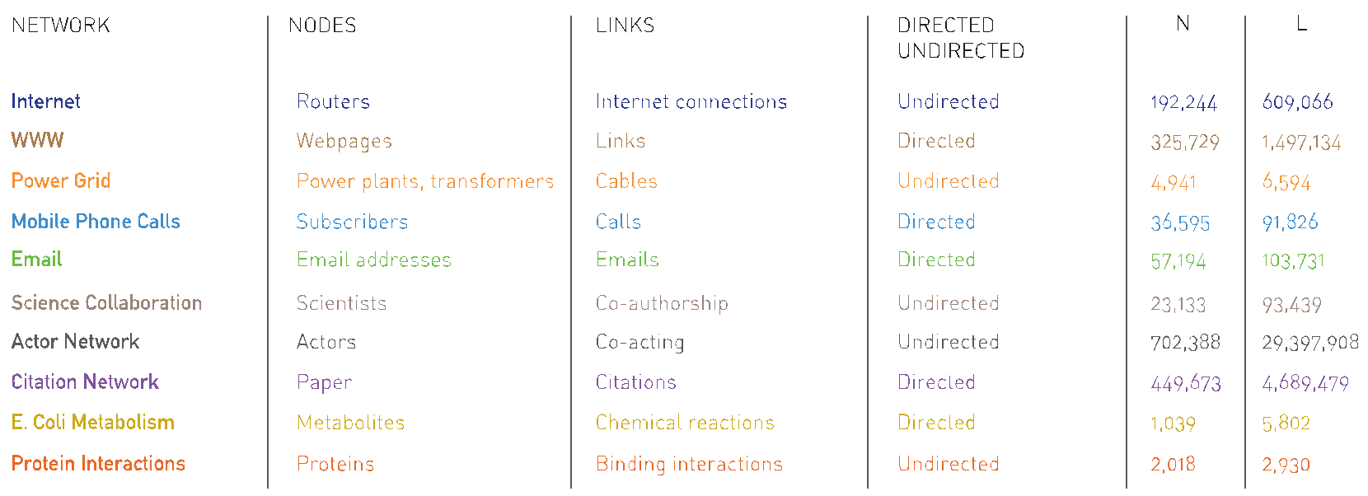
Section 2.2 Reference Networks

Slide 21
Question 4
Q4: Adjacency Matrices

Slide 22
Section 2.4
Adjacency matrix

Slide 23
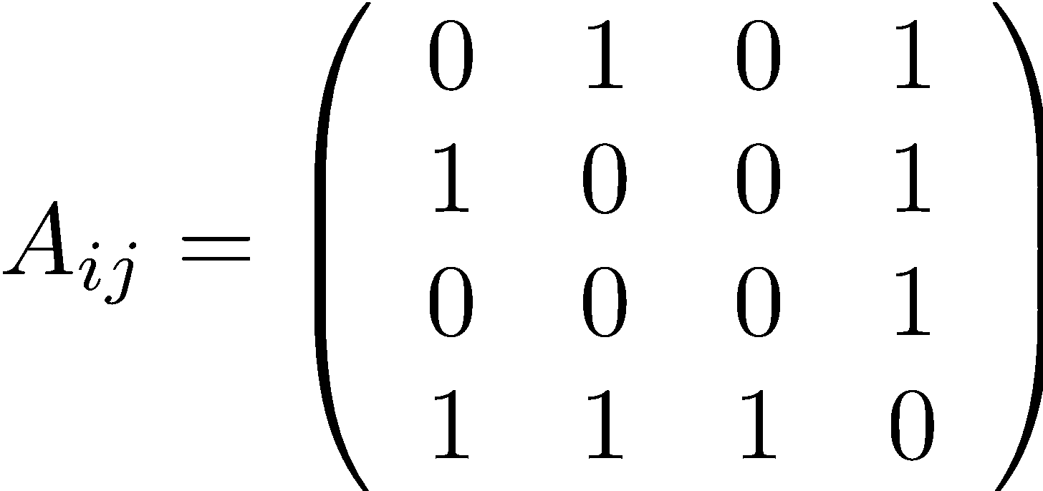
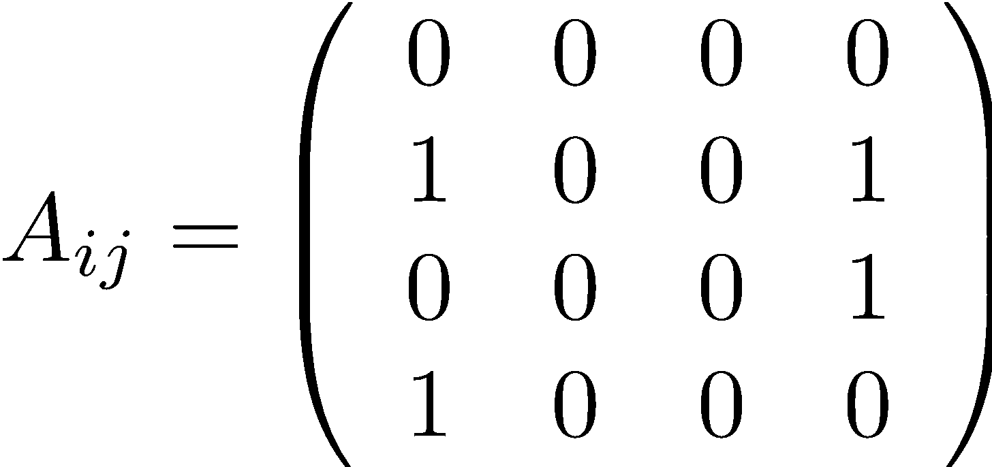
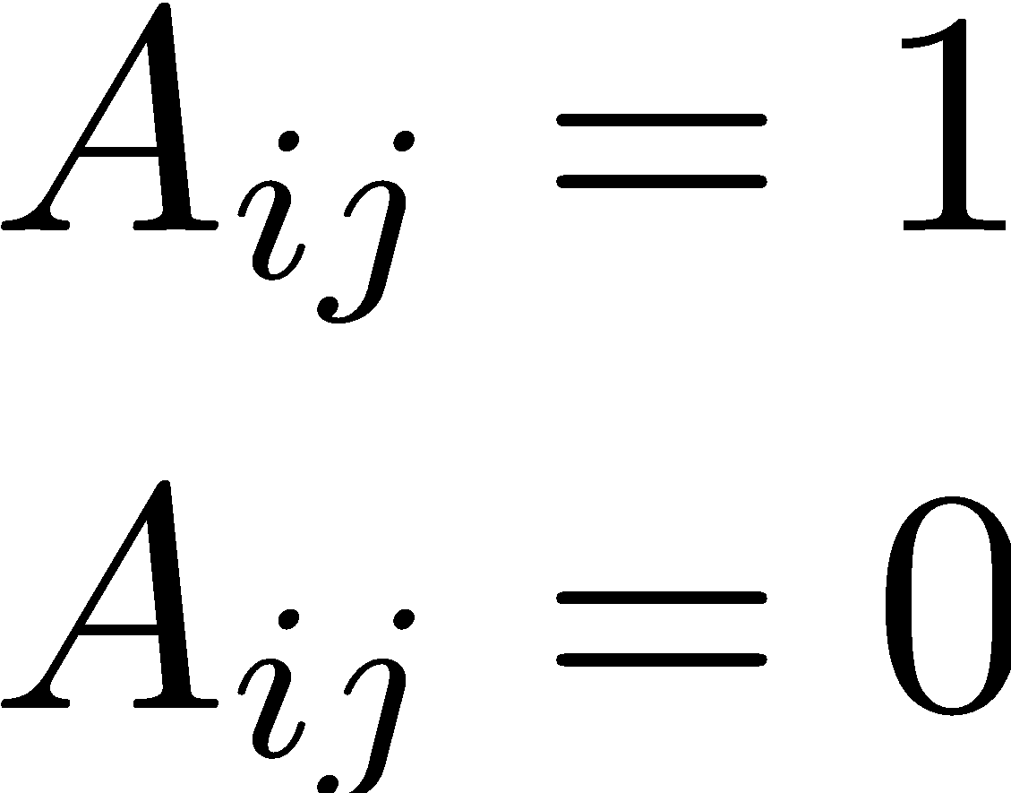
ADJACENCY MATRIX
4
4
3
2
3
2
1
1
A_{ij}=1 if there is a link between node i and j
A_{ij}=0 if nodes i and j are not connected to each other.
Note that for a directed graph (right) the matrix is not symmetric.
if there is a link pointing from node j and i
if there is no link pointing from j to i.
Network Science: Graph Theory

Slide 24
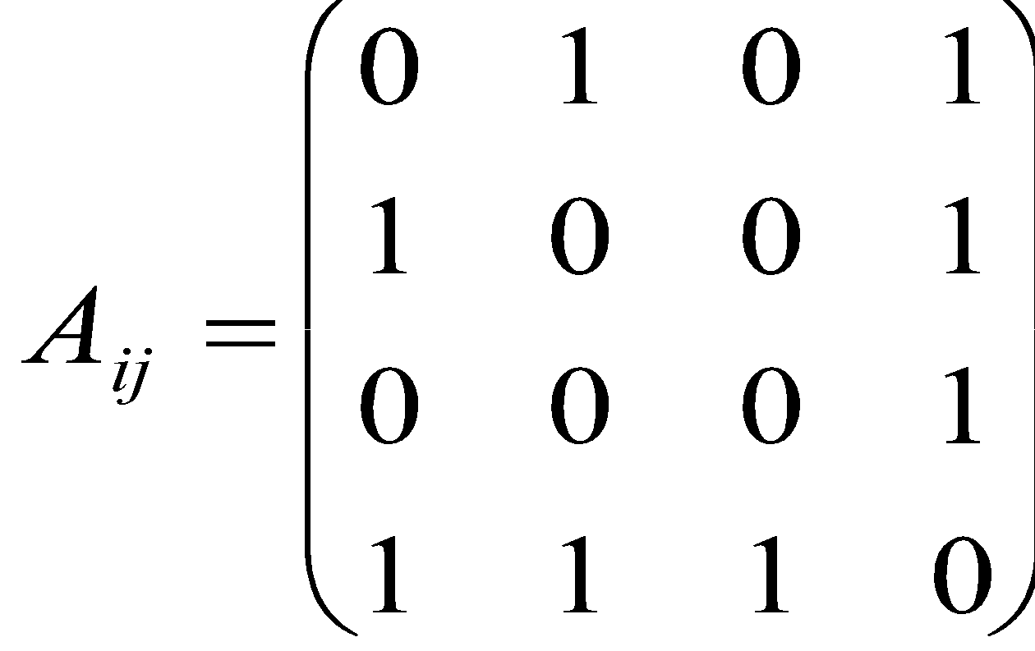
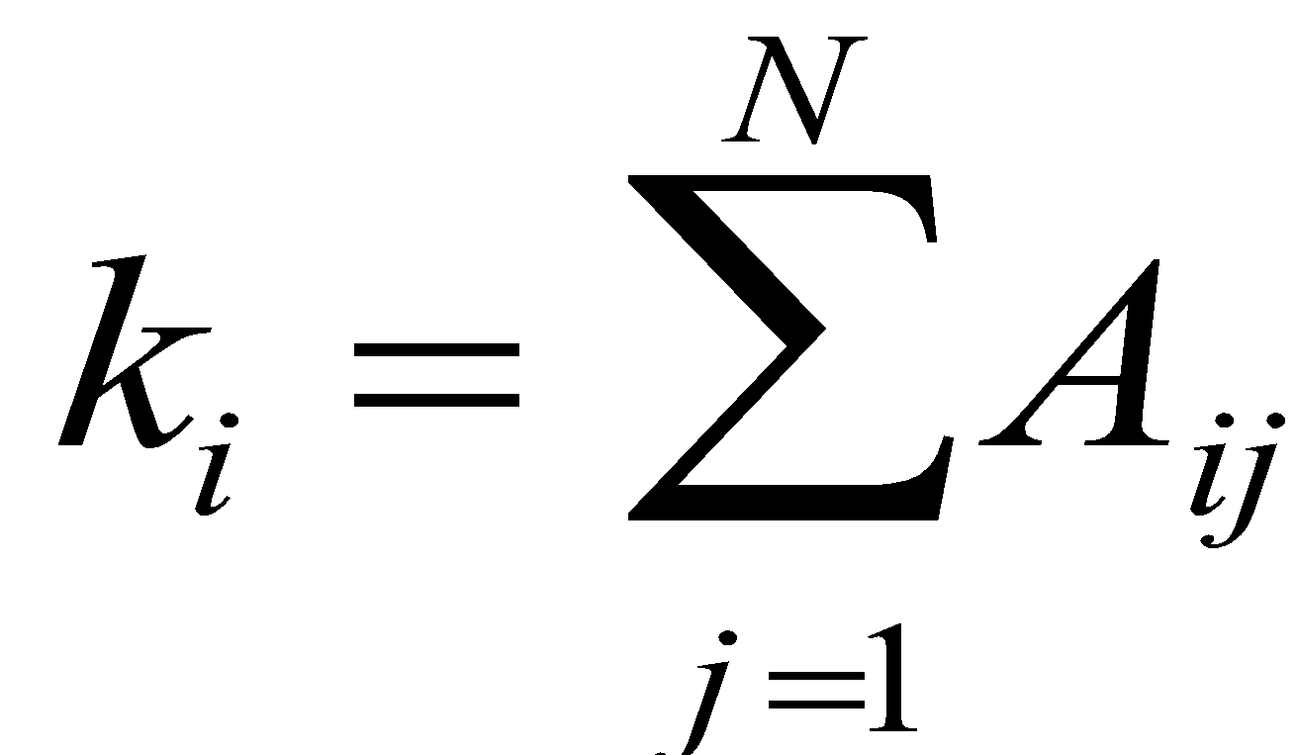
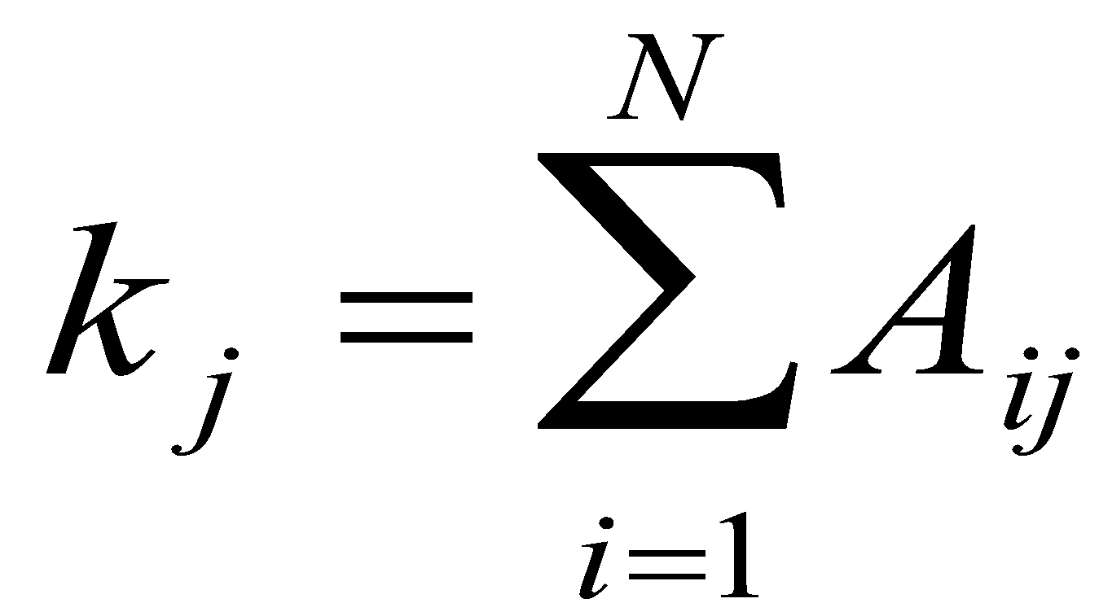
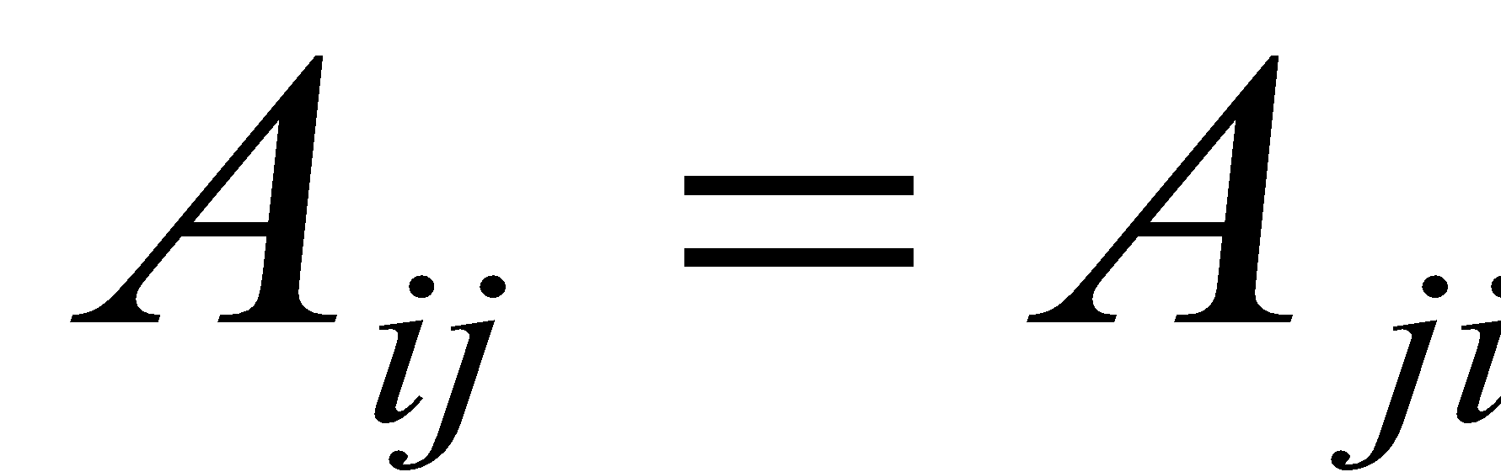
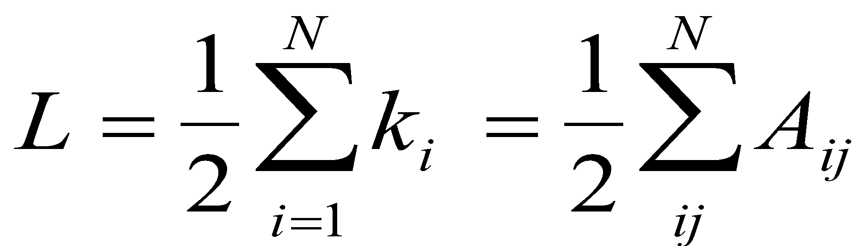
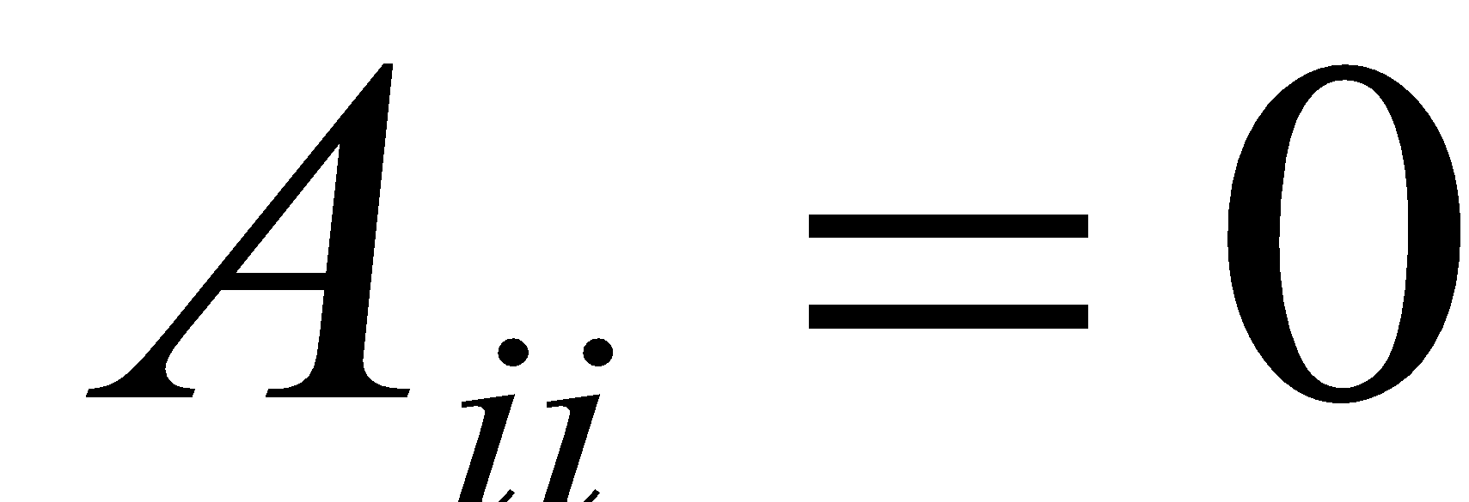
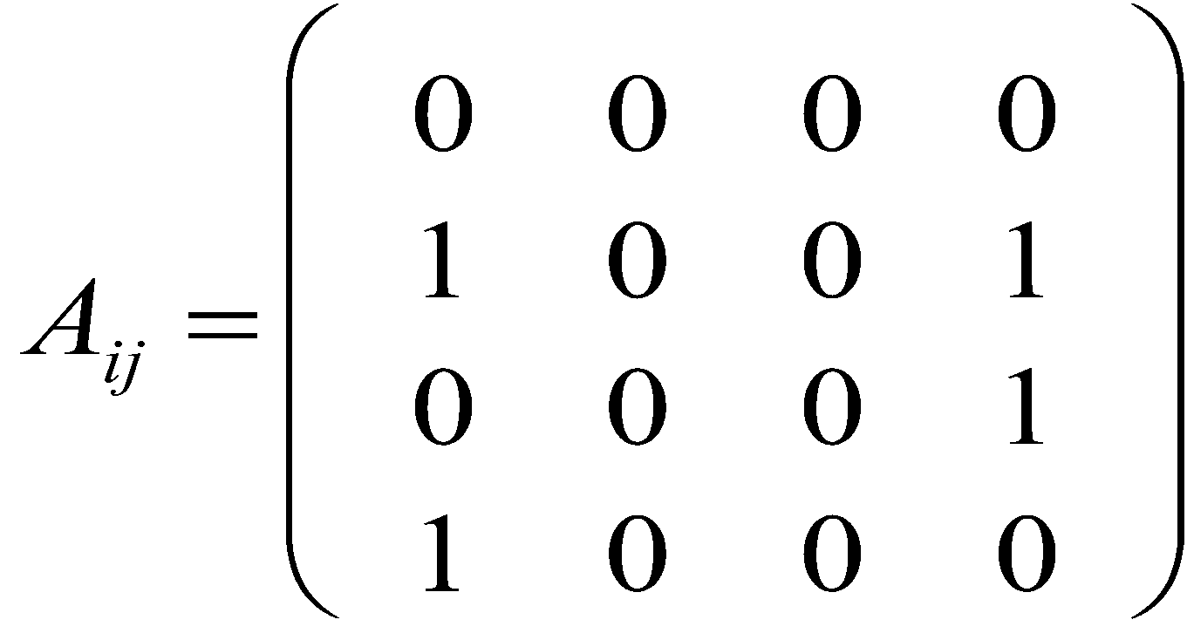
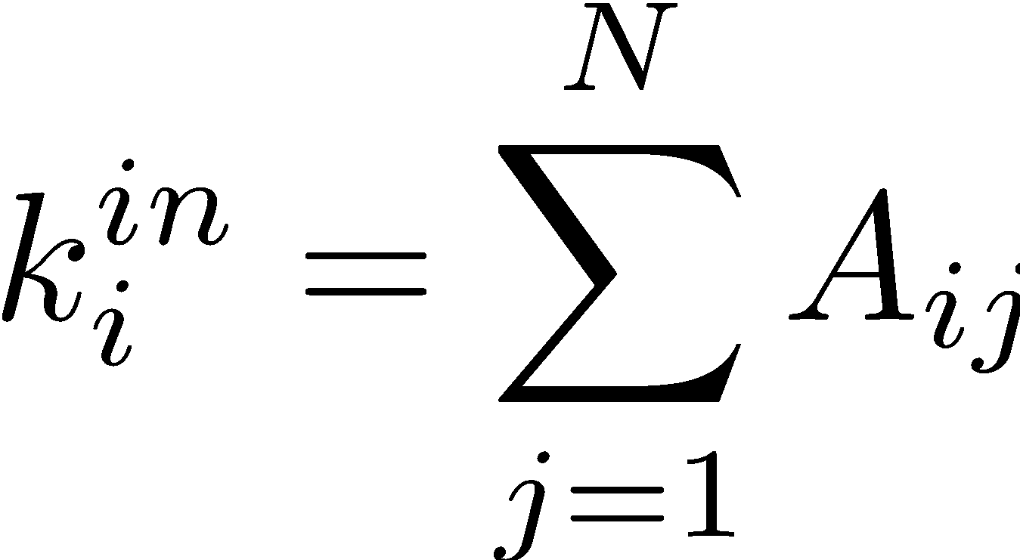
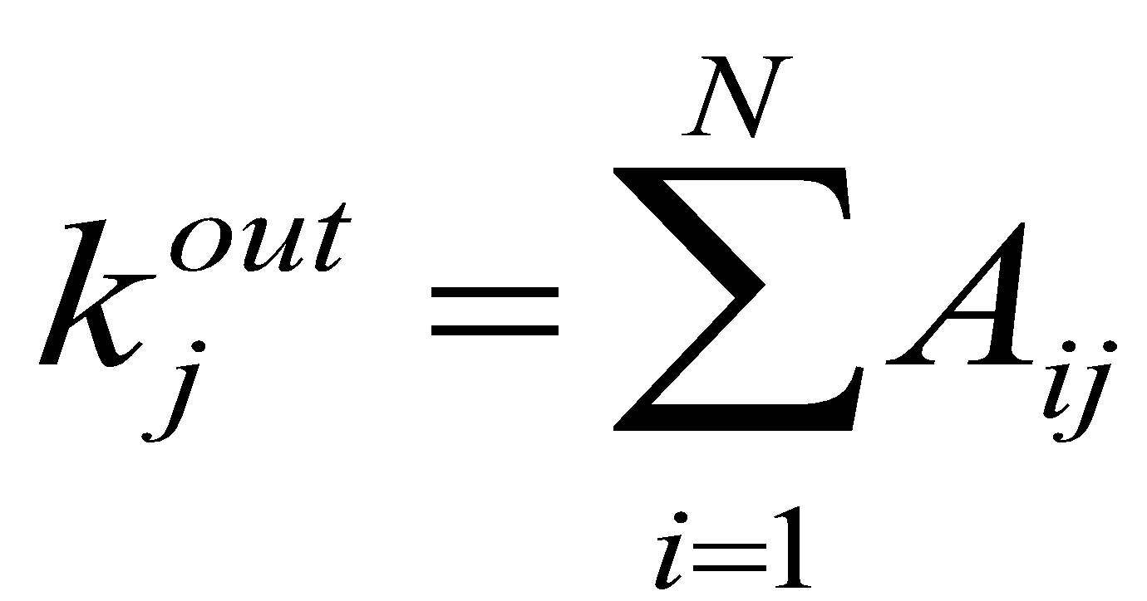
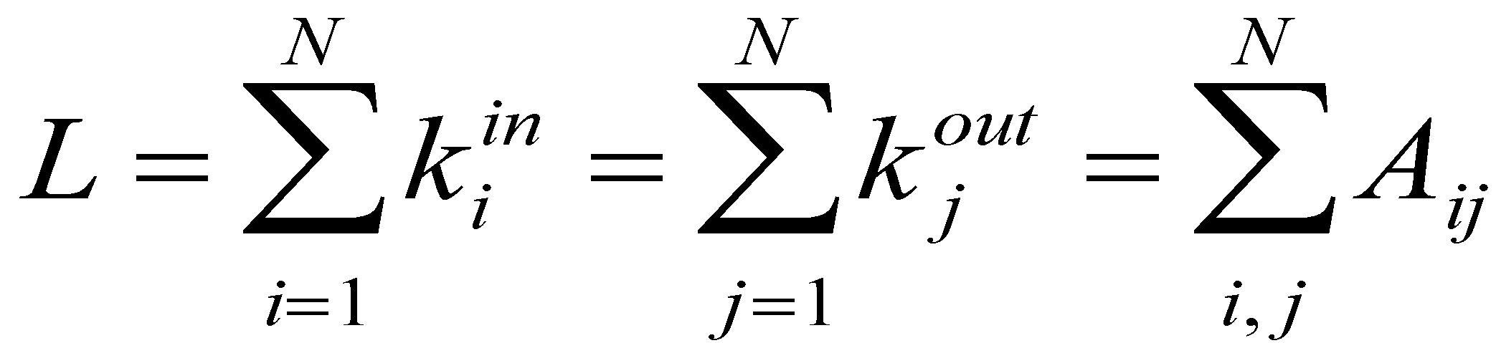
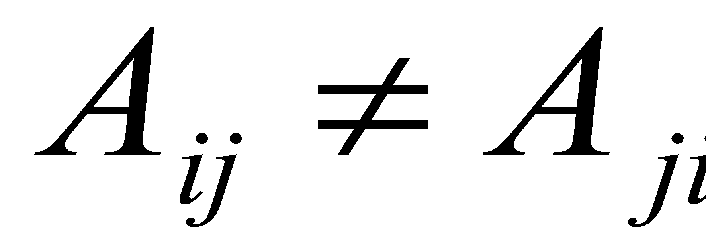
ADJACENCY MATRIX AND NODE DEGREES
4
Undirected
2
3
1
Directed
4
2
3
1

Slide 25
ADJACENCY MATRIX
a
e
a b c d e f g h
a 0 1 0 0 1 0 1 0
b 1 0 1 0 0 0 0 1
c 0 1 0 1 0 1 1 0
d 0 0 1 0 1 0 0 0
e 1 0 0 1 0 0 0 0
f 0 0 1 0 0 0 1 0
g 1 0 1 0 0 0 0 0
h 0 1 0 0 0 0 0 0
h
b
d
f
g
c
Network Science: Graph Theory
Notes:
The adjacency matrix can take far more complicated forms for a larger network….

Slide 26
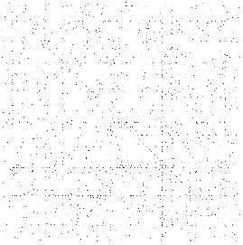
ADJACENCY MATRICES ARE SPARSE
Network Science: Graph Theory
Notes:
The adjacency matrix of the yeast protein-protein interaction network, consisting of 2,018 nodes, each representing a yeast protein (Table 2.1). A dot is placed on each spot of the adjacent matrix for which Aij = 1, indicating the presence of an interaction. There are no dots for Aij = 0. The small fraction of dots underlines the sparse nature of the protein-protein interaction network.

Slide 27
Question 5
Q5: Sparseness

Slide 28
Section 4
Real networks are sparse

Slide 29
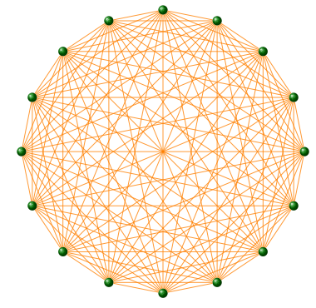
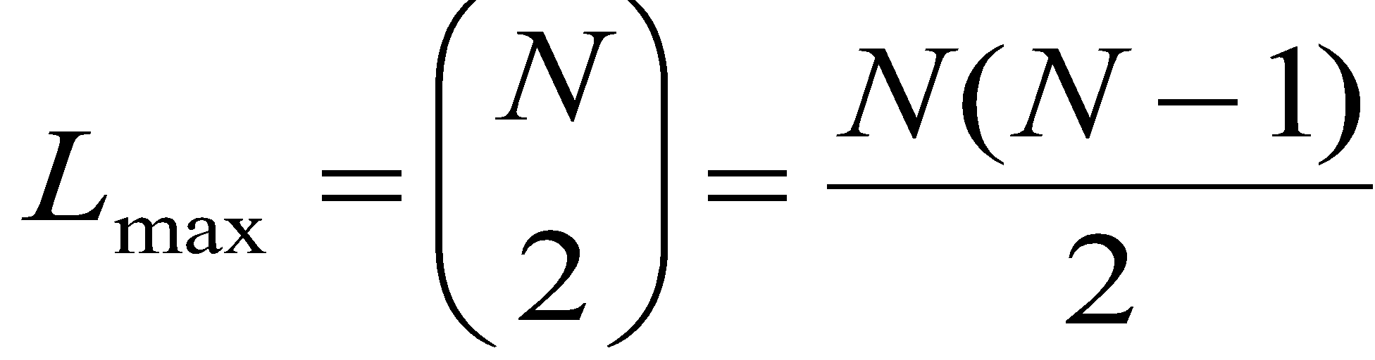
COMPLETE GRAPH
The maximum number of links a network
of N nodes can have is:
A graph with degree L=L_{max} is called a complete graph,
and its average degree is <k>=N-1
Network Science: Graph Theory

Slide 30
REAL NETWORKS ARE SPARSE
Most networks observed in real systems are sparse:
L << L_{max}
or
<k> <<N-1.
WWW (ND Sample): N=325,729; L=1.4 10⁶ L_{max}=10¹² <k>=4.51
Protein (S. Cerevisiae): N= 1,870; L=4,470 L_{max}=10⁷ <k>=2.39
Coauthorship (Math): N= 70,975; L=2 10⁵ L_{max}=3 10¹⁰ <k>=3.9
Movie Actors: N=212,250; L=6 10⁶ L_{max}=1.8 10¹³ <k>=28.78
(Source: Albert, Barabasi, RMP2002)
Network Science: Graph Theory

Slide 31
ADJACENCY MATRICES ARE SPARSE
Network Science: Graph Theory
Notes:
The adjacency matrix of the yeast protein-protein interaction network, consisting of 2,018 nodes, each representing a yeast protein (Table 2.1). A dot is placed on each spot of the adjacent matrix for which Aij = 1, indicating the presence of an interaction. There are no dots for Aij = 0. The small fraction of dots underlines the sparse nature of the protein-protein interaction network.

Slide 32
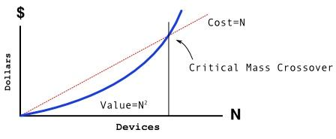
METCALFE’S LAW
The maximum number of links a network
of N nodes can have is:
Network Science: Graph Theory
Notes:
Metcalfe's law, frequently quoted during the internet boom of 2000, states that the value of a network is proportional to the square of the number of its nodes, i.e. $N^2$. Formulated around 1980 in terms of communication devices by Robert M. Metcalfe, the inventor of Ethernet\cite{Gilder_Forbes-ASAP_1993}, the idea behind Metcalfe's law is that the more individuals use a network, the more valuable it becomes. Indeed, a fax machine is useless to you if there is no one to send a fax to. The more of your acquaintances have a fax machine, the more valuable it is to you as well. The $N^2$ dependence encodes the fact that if a network has $N=10$ members, there are $L_{max}=45$ different possible connections that these members can make to each other. If the network doubles in size to $N=20$, the number of connections doesn't merely double but roughly quadruples to 190, an effect often called "network effect" or "network externality" in economics.
During the Internet boom Metcalfe's law was frequently used to offer a quantitative valuation for internet companies, supporting a "build it and they will come " mentality\cite{Briscoe_Spectrum-IEEE_2006}. It implied that the value of a service is proportional to the square of the number of its consumers or users, while costs would grow only linearly. Hence if the service attracts sufficient number of users, it will inevitably become profitable, as $N^2$ will surely surpass $N$ at some sufficiently large $N$ value. Hence Metcalf's Law offered credibility to growth, while neglecting profitability, fueling the Internet bubble of 2001.
Metcalfe's law imagines that networks are complete graphs. It is based on Eq. (\ref{EQ-L-Max}), indicating that if all links of communication network with $N$ nodes are equally valuable, the total value of the network is proportional to $N(N-1)/2$, that is, roughly, $N^2$.
There are two fundamental problems with Metcalfe's law:
While all links are possible, in real networks not all links are present. Indeed, most real networks are sparse, which means that only a very small fraction of the links are present. If we assign a value to each link, then the total value of the network will grow slower than $N^2$, as we will see in the coming chapters.
Not all links are of equal value. Some links are used heavily while the vast majority of links are 'weak', i.e. they are rarely utilized.

Slide 33
Section 2.6
WEIGHTED AND UNWEIGHTED NETWORKS

Slide 34
WEIGHTED AND UNWEIGHTED NETWORKS

Slide 35
METCALFE’S LAW
The maximum number of links a network
of N nodes can have is:
Network Science: Graph Theory
Notes:
Metcalfe's law, frequently quoted during the internet boom of 2000, states that the value of a network is proportional to the square of the number of its nodes, i.e. $N^2$. Formulated around 1980 in terms of communication devices by Robert M. Metcalfe, the inventor of Ethernet\cite{Gilder_Forbes-ASAP_1993}, the idea behind Metcalfe's law is that the more individuals use a network, the more valuable it becomes. Indeed, a fax machine is useless to you if there is no one to send a fax to. The more of your acquaintances have a fax machine, the more valuable it is to you as well. The $N^2$ dependence encodes the fact that if a network has $N=10$ members, there are $L_{max}=45$ different possible connections that these members can make to each other. If the network doubles in size to $N=20$, the number of connections doesn't merely double but roughly quadruples to 190, an effect often called "network effect" or "network externality" in economics.
During the Internet boom Metcalfe's law was frequently used to offer a quantitative valuation for internet companies, supporting a "build it and they will come " mentality\cite{Briscoe_Spectrum-IEEE_2006}. It implied that the value of a service is proportional to the square of the number of its consumers or users, while costs would grow only linearly. Hence if the service attracts sufficient number of users, it will inevitably become profitable, as $N^2$ will surely surpass $N$ at some sufficiently large $N$ value. Hence Metcalf's Law offered credibility to growth, while neglecting profitability, fueling the Internet bubble of 2001.
Metcalfe's law imagines that networks are complete graphs. It is based on Eq. (\ref{EQ-L-Max}), indicating that if all links of communication network with $N$ nodes are equally valuable, the total value of the network is proportional to $N(N-1)/2$, that is, roughly, $N^2$.
There are two fundamental problems with Metcalfe's law:
While all links are possible, in real networks not all links are present. Indeed, most real networks are sparse, which means that only a very small fraction of the links are present. If we assign a value to each link, then the total value of the network will grow slower than $N^2$, as we will see in the coming chapters.
Not all links are of equal value. Some links are used heavily while the vast majority of links are 'weak', i.e. they are rarely utilized.

Slide 36
Question 5
Q6: Bipartite Networks

Slide 37
Section 2.7
BIPARTITE NETWORKS

Slide 38
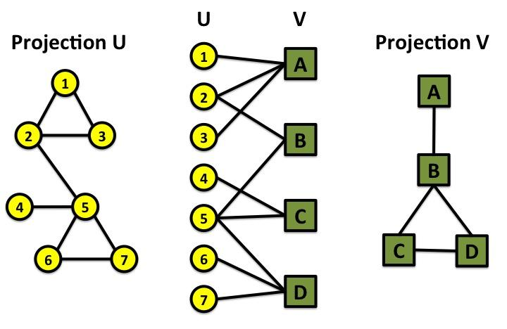
BIPARTITE GRAPHS
bipartite graph (or bigraph) is a graph whose nodes can be divided into two disjoint sets U and V such that every link connects a node in U to one in V; that is, U and V are independent sets.
Examples:
Hollywood actor network
Collaboration networks
Disease network (diseasome)
Network Science: Graph Theory

Slide 39
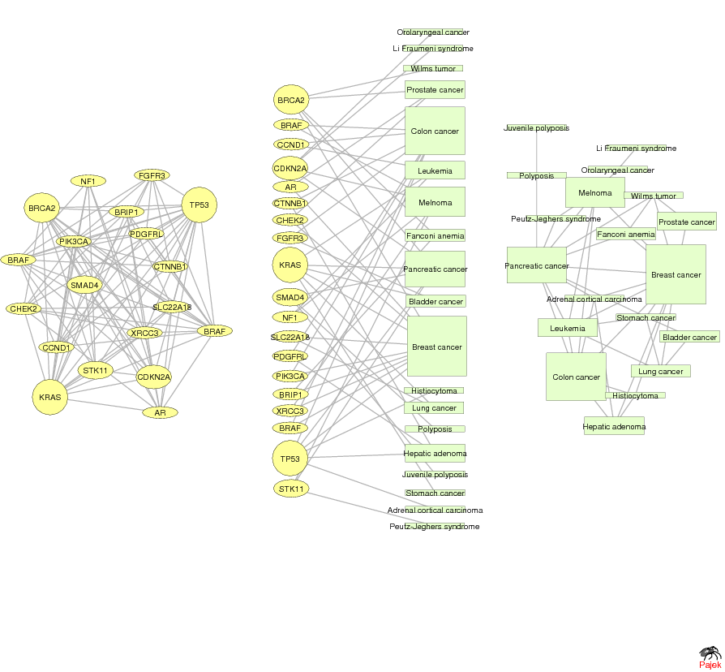
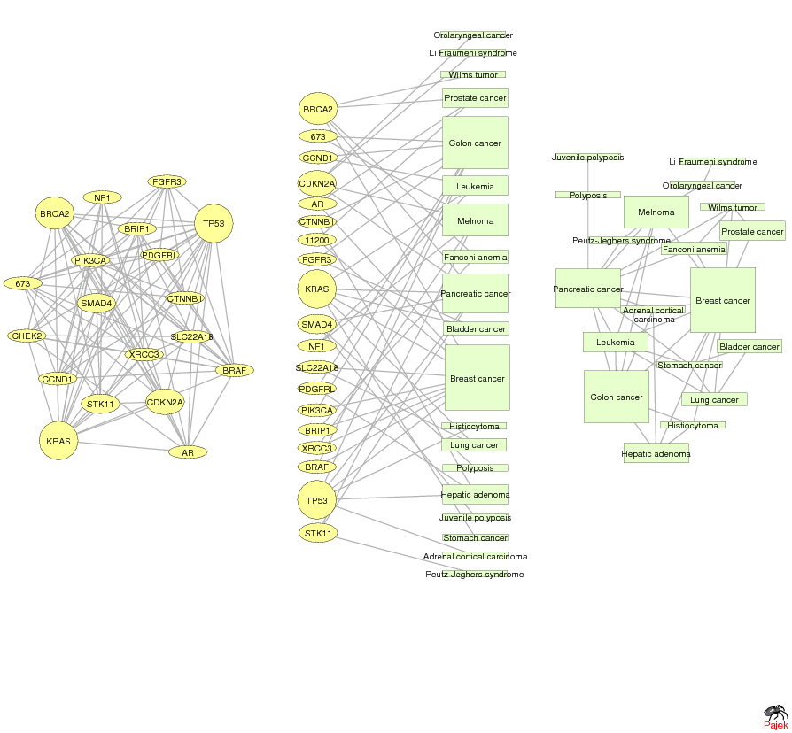
GENE NETWORK – DISEASE NETWORK
DISEASOME
PHENOME
GENOME
Gene network
Disease network
Goh, Cusick, Valle, Childs, Vidal & Barabási, PNAS (2007)
Network Science: Graph Theory

Slide 40
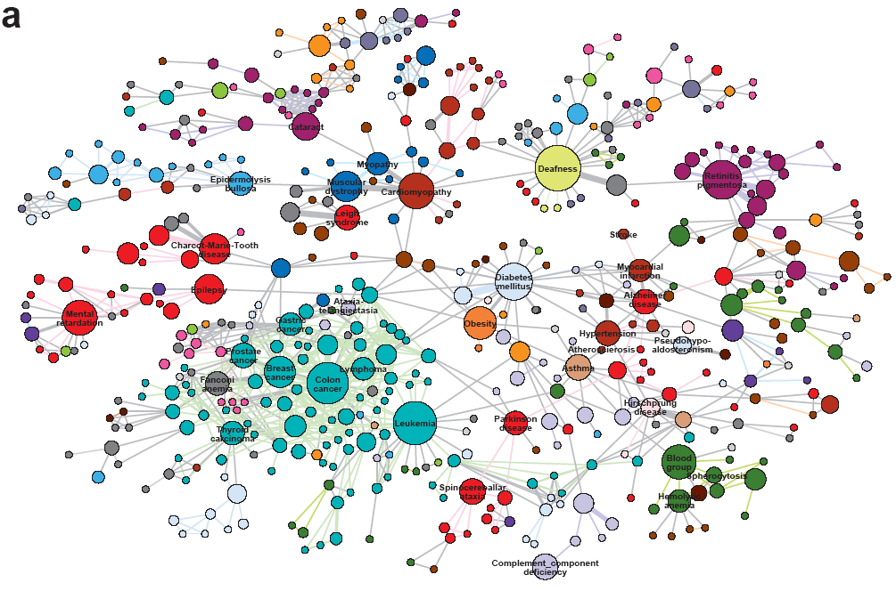
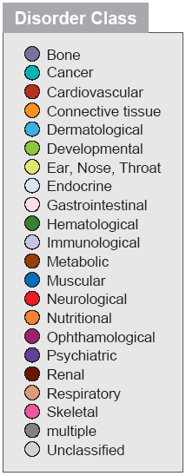
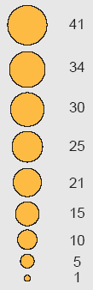
HUMAN DISEASE NETWORK

Slide 41
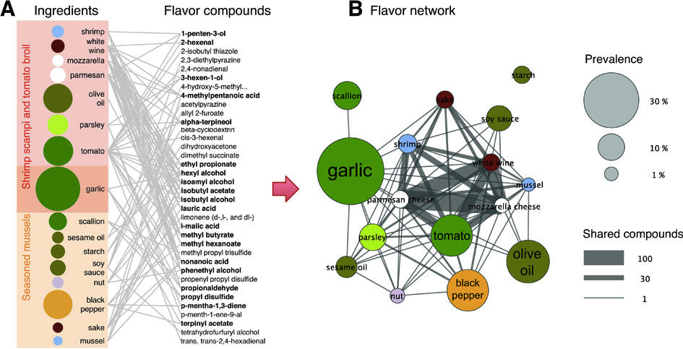
Ingredient-Flavor Bipartite Network
Y.-Y. Ahn, S. E. Ahnert, J. P. Bagrow, A.-L. Barabási Flavor network and the principles of food pairing , Scientific Reports 196, (2011).
Network Science: Graph Theory

Slide 42
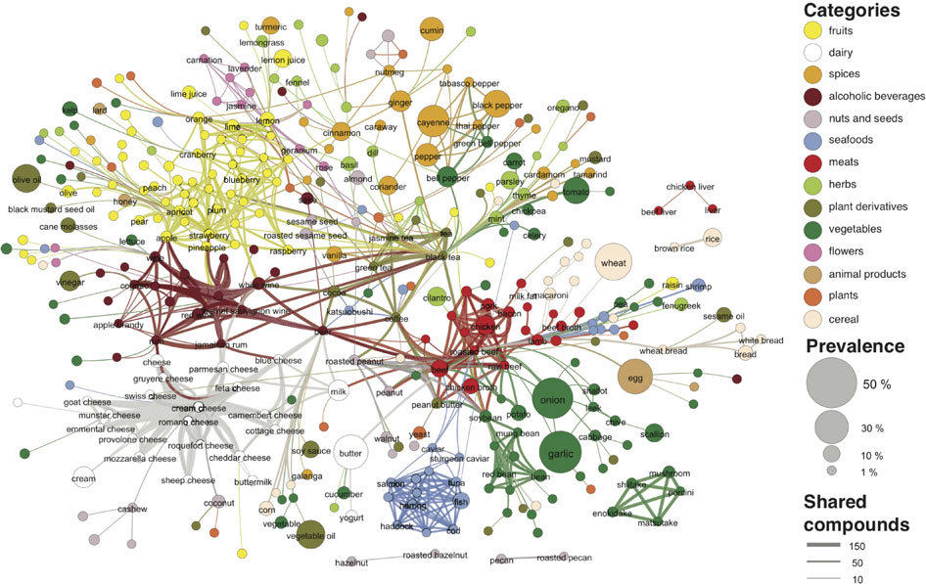

Slide 43
Question 6
Q6: Paths

Slide 44
Section 2.8
PATHOLOGY

Slide 45


PATHS
A path is a sequence of nodes in which each node is adjacent to the next one
P_{i0,in} of length n between nodes i₀ and i_{n} is an ordered collection of n+1 nodes and n links
In a directed network, the path can follow only the direction of an arrow.
Network Science: Graph Theory

Slide 46
DISTANCE IN A GRAPH Shortest Path, Geodesic Path
The distance (shortest path, geodesic path) between two nodes is defined as the number of edges along the shortest path connecting them.
*If the two nodes are disconnected, the distance is infinity.
In directed graphs each path needs to follow the direction of the arrows.
Thus in a digraph the distance from node A to B (on an AB path) is generally different from the distance from node B to A (on a BCA path).
B
A
C
D
B
A
C
D
Network Science: Graph Theory

Slide 47


NUMBER OF PATHS BETWEEN TWO NODES Adjacency Matrix
N_{ij}, number of paths between any two nodes i and j:
Length n=1: If there is a link between i and j, then A_{ij}=1 and A_{ij}=0 otherwise.
Length n=2: If there is a path of length two between i and j, then A_{ik}A_{kj}=1, and A_{ik}A_{kj}=0 otherwise.
The number of paths of length 2:
Length n: In general, if there is a path of length n between i and j, then A_{ik}…A_{lj}=1 and A_{ik}…A_{lj}=0 otherwise.
The number of paths of length n between i and j is*
*holds for both directed and undirected networks.
Network Science: Graph Theory

Slide 48
FINDING DISTANCES: BREADTH FIRST SEARCH
Distance between node 0 and node 4:
Start at 0.
1
1
1
3
3
4
1
2
4
3
2
1
1
1
3
0
4
2
4
3
3
4
1
4
3
4
4
2
2
3
Network Science: Graph Theory
Network Science: Graph Theory
Network Science: Graph Theory

Slide 49
FINDING DISTANCES: BREADTH FIRST SEARCH
Distance between node 0 and node 4:
Start at 0.
Find the nodes adjacent to 1. Mark them as at distance 1. Put them in a queue.
3
3
4
2
4
2
1
3
1
1
0
1
3
1
4
2
4
3
3
4
1
1
4
3
4
4
2
2
3
Network Science: Graph Theory
Network Science: Graph Theory

Slide 50
FINDING DISTANCES: BREADTH FIRST SEARCH
Distance between node 0 and node 4:
Start at 0.
Find the nodes adjacent to 0. Mark them as at distance 1. Put them in a queue.
Take the first node out of the queue. Find the unmarked nodes adjacent to it in the graph. Mark them with the label of 2. Put them in the queue.
3
3
4
2
2
4
2
1
3
3
2
1
1
1
4
1
0
1
2
2
4
3
3
4
1
1
1
4
3
4
4
2
2
2
2
3
Network Science: Graph Theory
Network Science: Graph Theory
Network Science: Graph Theory

Slide 51
FINDING DISTANCES: BREADTH FIRST SEARCH
Distance between node 0 and node 4:
Repeat until you find node 4 or there are no more nodes in the queue.
The distance between 0 and 4 is the label of 4 or, if 4 does not have a label, infinity.
3
3
4
2
4
3
2
1
0
1
3
4
2
4
3
3
4
1
4
3
4
4
2
2
3
Network Science: Graph Theory

Slide 52


NETWORK DIAMETER AND AVERAGE DISTANCE
Diameter: d_{max} the maximum distance between any pair of nodes in the graph.
Average path length/distance, <d>, for a connected graph:
where d_{ij} is the distance from node i to node j
In an undirected graph d_{ij} =d_{ji} , so we only need to count them once:
Network Science: Graph Theory

Slide 53




PATHOLOGY: summary
Shortest Path
1
2
5
3
4
The path with the shortest length between two nodes (distance).
Network Science: Graph Theory

Slide 54

PATHOLOGY: summary
Diameter
Average Path Length
1
1
2
5
2
5
3
4
3
4
The longest shortest path in a graph
The average of the shortest paths for all pairs of nodes.
Network Science: Graph Theory

Slide 55
PATHOLOGY: summary
Cycle
Self-avoiding Path
1
1
2
5
2
5
3
4
3
4
A path with the same start and end node.
A path that does not intersect itself.
Network Science: Graph Theory

Slide 56
PATHOLOGY: summary
Eulerian Path
Hamiltonian Path
1
1
2
5
2
5
3
4
3
4
A path that traverses each link exactly once.
A path that visits each node exactly once.
Network Science: Graph Theory

Slide 57
Section 2.9
CONNECTEDNESS

Slide 58
CONNECTIVITY OF UNDIRECTED GRAPHS
Connected (undirected) graph: any two vertices can be joined by a path.
A disconnected graph is made up by two or more connected components.
B
B
A
Largest Component:
Giant Component
A
F
C
D
F
C
D
F
The rest: Isolates
F
G
G
Bridge: if we erase it, the graph becomes disconnected.
Network Science: Graph Theory
Notes:
The phone is useless as a communication device if con not call any user with a valid number. Similarly, the Internet is useless as a communication system if you cannot send a message to any other user that has access to it. From a network perspective this means that that the technology behind the phone must be able to establish a path between your device and the device you are calling and that there needs to exist a path on the internet between any two computers with Internet access.
This is infact the key utility of most networks: they connect the system's components. This does not require a direct link between any two nodes, but only the existence of a path between them. These paths play an essential role in most network effects and the essence of a network is to guarantee connectedness. In this section we discuss the graph theoretic formulation of the connectedness problem.

Slide 59

CONNECTIVITY OF UNDIRECTED GRAPHS Adjacency Matrix
The adjacency matrix of a network with several components can be written in a block-diagonal form, so that nonzero elements are confined to squares, with all other elements being zero:
Network Science: Graph Theory

Slide 60
CONNECTIVITY OF DIRECTED GRAPHS
Strongly connected directed graph: has a path from each node to
every other node and vice versa (e.g. AB path and BA path).
Weakly connected directed graph: it is connected if we disregard the
edge directions.
Strongly connected components can be identified, but not every node is part
of a nontrivial strongly connected component.
B
E
A
B
F
A
D
E
C
D
C
G
F
G
In-component: nodes that can reach the scc,
Out-component: nodes that can be reached from the scc.
Network Science: Graph Theory

Slide 61

Section 2.9

Slide 62
Section 10
Clustering coefficient

Slide 63


CLUSTERING COEFFICIENT
Clustering coefficient:
what fraction of your neighbors are connected?
Node i with degree k_{i}
C_{i} in [0,1]
Watts & Strogatz, Nature 1998.
Network Science: Graph Theory

Slide 64

CLUSTERING COEFFICIENT
Clustering coefficient:
what fraction of your neighbors are connected?
Node i with degree k_{i}
C_{i} in [0,1]
Watts & Strogatz, Nature 1998.
Network Science: Graph Theory

Slide 65
Section 11
summary

Slide 66
THREE CENTRAL QUANTITIES IN NETWORK SCIENCE
Degree distribution: P(k)
Path length: <d>
Clustering coefficient:
Network Science: Graph Theory

Slide 67




GRAPHOLOGY
1
Undirected
Directed
4
4
1
1
2
2
3
3
Actor network, protein-protein interactions
WWW, citation networks
Network Science: Graph Theory

Slide 68




GRAPHOLOGY
2
Unweighted
(undirected)
Weighted
(undirected)
4
4
1
1
2
2
3
3
protein-protein interactions, www
Call Graph, metabolic networks
Network Science: Graph Theory

Slide 69



GRAPHOLOGY
3
Self-interactions
Multigraph
(undirected)
4
4
1
1
2
2
3
3
Protein interaction network, www
Social networks, collaboration networks
Network Science: Graph Theory

Slide 70


GRAPHOLOGY
4
Complete Graph
(undirected)
4
1
2
3
Actor network, protein-protein interactions
Network Science: Graph Theory

Slide 71
GRAPHOLOGY: Real networks can have multiple characteristics
WWW > directed multigraph with self-interactions
Protein Interactions > undirected unweighted with self-interactions
Collaboration network > undirected multigraph or weighted.
Mobile phone calls > directed, weighted.
Facebook Friendship links > undirected, unweighted.
Network Science: Graph Theory

Slide 72

THREE CENTRAL QUANTITIES IN NETWORK SCIENCE
A. Degree distribution: p_{k}
B. Path length: <d>
C. Clustering coefficient:
Network Science: Graph Theory

Slide 73









Bio-Map
GENOME
protein-gene interactions
PROTEOME
protein-protein interactions
METABOLISM
Bio-chemical reactions
Citrate Cycle

Slide 74


Metab-movie
Metabolic Network
Protein Interactions

Slide 75


A CASE STUDY: PROTEIN-PROTEIN INTERACTION NETWORK
Undirected network
N=2,018 proteins as nodes
L=2,930 binding interactions as links.
Average degree <k>=2.90.
Not connected: 185 components
the largest (giant component) 1,647 nodes
Network Science: Graph Theory
Notes:
Let us discuss some of characteristics of this network, relying on the quantities we introduced so far. The undirected network has $N=2,018$ proteins as nodes and $L=2,930$ binding interactions as links.
Hence the average degree is $2.90$, suggesting that a typical protein interacts with approximately three other proteins. Yet, this number is somewhat misleading.
The breath first search algorithm will also convince us that the protein interaction network is not connected, but consists of 185 components, shown as isolated clusters in Fig. \ref{F-G-PPI-Overall}a. The largest, called the giant component, contains 1,647 of the 2,018 nodes; all other components are tiny compared to it. As we will see in the coming chapters, such fragmentation is common in model networks.
Finally, a visual inspection reveals an interesting pattern: hubs have a tendency to connect to small nodes, giving the network a hub and spoke character. This is a consequence of \textit{degree correlations}, reflecting the {\it dissasortative } nature of the protein interaction network. Degree correlations influence a number of network characteristics, from the spread of ideas and viruses in social networks to the number of driver nodes needed to control a network.

Slide 76
A CASE STUDY: PROTEIN-PROTEIN INTERACTION NETWORK
Undirected network
N=2,018 proteins as nodes
L=2,930 binding interactions as links.
Average degree <k>=2.90.
Not connected: 185 components
the largest (giant component) 1,647 nodes
Network Science: Graph Theory
Notes:
Let us discuss some of characteristics of this network, relying on the quantities we introduced so far. The undirected network has $N=2,018$ proteins as nodes and $L=2,930$ binding interactions as links.
Hence the average degree is $2.90$, suggesting that a typical protein interacts with approximately three other proteins. Yet, this number is somewhat misleading.
The breath first search algorithm will also convince us that the protein interaction network is not connected, but consists of 185 components, shown as isolated clusters in Fig. \ref{F-G-PPI-Overall}a. The largest, called the giant component, contains 1,647 of the 2,018 nodes; all other components are tiny compared to it. As we will see in the coming chapters, such fragmentation is common in model networks.
Finally, a visual inspection reveals an interesting pattern: hubs have a tendency to connect to small nodes, giving the network a hub and spoke character. This is a consequence of \textit{degree correlations}, reflecting the {\it dissasortative } nature of the protein interaction network. Degree correlations influence a number of network characteristics, from the spread of ideas and viruses in social networks to the number of driver nodes needed to control a network.

Slide 77

A CASE STUDY: PROTEIN-PROTEIN INTERACTION NETWORK
p_{k} is the probability that a node has degree k.
N_{k} = # nodes with degree k
p_{k} = N_{k} / N
Network Science: Graph Theory
Notes:
Indeed, the degree distribution $p_k$ shown in Fig. \ref{F-G-PPI-Overall}b indicates that the vast majority of nodes have only a few links. To be precise, in this network 69% of nodes have fewer than three links, i.e. for these $k < \langle k \rangle$. They coexist with a few highly connected nodes, or hubs, the largest having as many as 91 links. Such wide differences in node degrees is a consequence of the network's {\it scale-free property}, a property encountered in many real networks. We will see that the shape of the degree distribution determines a wide range of network properties, from a network's robustness to node failures to the spread of viruses.
If we use the breath-first-search algorithm, we can determine the network's diameter, finding $d_{max}=14$. We might be tempted to expect wide variations in $d$, as some nodes are close to each other, others, however, maybe quite far. The distance distribution (Fig. \ref{F-G-PPI-Overall}c), indicates otherwise: $p_d$ has a prominent peak around $\langle d \rangle=5.61$, indicating that most distances are rather short, being in the vicinity of $\langle d \rangle$. Also, $p_d$ decays fast for large $\langle d \rangle$, suggesting that large distances are essentially absent. These are manifestations of the {\it small world property}, another common feature of real networks, indicating that most nodes are close to each other.
The breath first search algorithm will also convince us that the protein interaction network is not connected, but consists of 185 components, shown as isolated clusters in Fig. \ref{F-G-PPI-Overall}a. The largest, called the giant component, contains 1,647 of the 2,018 nodes; all other components are tiny compared to it. As we will see in the coming chapters, such fragmentation is common in model networks.
The average clustering coefficient of the network is $\langle C \rangle=0.12$, which, as we will come to appreciate, is rather large, indicating a significant degree of local clustering in the network. A further caveat is provided by the dependence of the clustering coefficient on the node's degree, or the $C(k)$ function (Fig. \ref{F-G-PPI-Overall}d), which indicates that the clustering coefficient of the small nodes is significantly higher than the clustering coefficient of the hubs. This suggests that the small degree nodes tend to be part of dense local neighborhoods, while the neighborhood of the hubs is much more sparse. This is a consequence of {\it network hierarchy}, another widely shared network property.
Finally, a visual inspection reveals an interesting pattern: hubs have a tendency to connect to small nodes, giving the network a hub and spoke character. This is a consequence of \textit{degree correlations}, reflecting the {\it dissasortative } nature of the protein interaction network. Degree correlations influence a number of network characteristics, from the spread of ideas and viruses in social networks to the number of driver nodes needed to control a network.
Taken together, Fig. \ref{F-G-PPI-Overall} illustrates that the quantities we introduced in this chapter can help us diagnose several key properties of real networks. The purpose of the coming chapters is to study systematically these network characteristics, understanding what they tell us about the behavior of complex systems.

Slide 78

A CASE STUDY: PROTEIN-PROTEIN INTERACTION NETWORK
d_{max}=14
<d>=5.61
Network Science: Graph Theory
Notes:
If we use the breath-first-search algorithm, we can determine the network's diameter, finding $d_{max}=14$. We might be tempted to expect wide variations in $d$, as some nodes are close to each other, others, however, maybe quite far. The distance distribution (Fig. \ref{F-G-PPI-Overall}c), indicates otherwise: $p_d$ has a prominent peak around $\langle d \rangle=5.61$, indicating that most distances are rather short, being in the vicinity of $\langle d \rangle$. Also, $p_d$ decays fast for large $\langle d \rangle$, suggesting that large distances are essentially absent. These are manifestations of the {\it small world property}, another common feature of real networks, indicating that most nodes are close to each other.
The breath first search algorithm will also convince us that the protein interaction network is not connected, but consists of 185 components, shown as isolated clusters in Fig. \ref{F-G-PPI-Overall}a. The largest, called the giant component, contains 1,647 of the 2,018 nodes; all other components are tiny compared to it. As we will see in the coming chapters, such fragmentation is common in model networks.
The average clustering coefficient of the network is $\langle C \rangle=0.12$, which, as we will come to appreciate, is rather large, indicating a significant degree of local clustering in the network. A further caveat is provided by the dependence of the clustering coefficient on the node's degree, or the $C(k)$ function (Fig. \ref{F-G-PPI-Overall}d), which indicates that the clustering coefficient of the small nodes is significantly higher than the clustering coefficient of the hubs. This suggests that the small degree nodes tend to be part of dense local neighborhoods, while the neighborhood of the hubs is much more sparse. This is a consequence of {\it network hierarchy}, another widely shared network property.
Finally, a visual inspection reveals an interesting pattern: hubs have a tendency to connect to small nodes, giving the network a hub and spoke character. This is a consequence of \textit{degree correlations}, reflecting the {\it dissasortative } nature of the protein interaction network. Degree correlations influence a number of network characteristics, from the spread of ideas and viruses in social networks to the number of driver nodes needed to control a network.
Taken together, Fig. \ref{F-G-PPI-Overall} illustrates that the quantities we introduced in this chapter can help us diagnose several key properties of real networks. The purpose of the coming chapters is to study systematically these network characteristics, understanding what they tell us about the behavior of complex systems.

Slide 79


A CASE STUDY: PROTEIN-PROTEIN INTERACTION NETWORK
<C>=0.12
Network Science: Graph Theory
Notes:
The average clustering coefficient of the network is $\langle C \rangle=0.12$, which, as we will come to appreciate, is rather large, indicating a significant degree of local clustering in the network. A further caveat is provided by the dependence of the clustering coefficient on the node's degree, or the $C(k)$ function (Fig. \ref{F-G-PPI-Overall}d), which indicates that the clustering coefficient of the small nodes is significantly higher than the clustering coefficient of the hubs. This suggests that the small degree nodes tend to be part of dense local neighborhoods, while the neighborhood of the hubs is much more sparse. This is a consequence of {\it network hierarchy}, another widely shared network property.
Taken together, Fig. \ref{F-G-PPI-Overall} illustrates that the quantities we introduced in this chapter can help us diagnose several key properties of real networks. The purpose of the coming chapters is to study systematically these network characteristics, understanding what they tell us about the behavior of complex systems.

Slide 80
FINAL PROJECTS

Slide 81
COMPONENTS OF THE PROJECT
DATA ACQUISITION
Downloading the data and putting it in a usable format
NETWORK RESPRESENTATION
What are the nodes and links
NETWORK ANALYSIS
What questions do you want to answer with this network, and which tools/measurements will you use?

Slide 82
DATA ACQUISITION
Many online data sources will have an API (application programming interface) that allows querying and downloading the data in a targeted way
Example: What are all movies from 1984-1995 starring Kevin Bacon and distributed by Paramount Pictures?
This is done either through a web interface or through a library within a programming language
Other sources will provide raw bulk data (e.g., Excel spreadsheets) that require processing, either manually or through a program you will write

Slide 83
NETWORK RECONSTRUCTION
Most datasets will admit more than one representation as a network
Some representations will be more or less informative than others
Figuring out the “network” that’s buried in your data is part of your project!

Slide 84
NETWORK RECONSTRUCTION
Suppose you have a list of students and the courses they are registered for
One possible network
Another possibility
Joe
PHYS 5116
Joe
Jane
BIO
1234
Jane
Sam
Sam

Slide 85

Books

Slide 86
Books
Like IMDB for books (contains books, ratings, reviews, recommendations, etc.)
API available at
https://www.goodreads.com/api
Potential areas of investigation:
Similarity network of books
Community detection (discovering genres)

Slide 87

Comics
Global comics database
http://www.comics.org/

Slide 88
Comics
Many different data bout each comic, e.g.:
Publisher
Who wrote script/penciled/inked
Publication date
Wiki and advanced search interface available
Potential areas of investigation:
Comics linked by common characters
Collaboration network between artists

Slide 89

Mendeley
http://www.mendeley.com/

Slide 90
Mendeley
Large scientific publication database/social network for researchers
API available (dev.mendeley.com)
Idea: use readership to assign authorship credit
Data consist of user profiles + papers the user has read
Publications (nodes) are linked if they are both present in one or more users’ lists
Use recently-developed techniques to infer authorship credit based on user perception: (http://www.pnas.org/content/111/34/12325.abstract)

Slide 91

3D Printing (1)

Slide 92
3D Printing (1)
How to lay out and visualize a network in 2 dimensional space is a well-developed field
Less clear is how to embed a network in 3D so it can be 3D printed.
Things to consider:
Make sure most nodes are distinguishable
Prevent “collisions” between links
Make sure the overall result is structurally sound

Slide 93

3D Printing (2)
C. Elegans connectome

Slide 94
3D Printing (2)
The C elegans neural network is the most accurately mapped nervous system with 279 neurons and 95 muscles connected by about 3500 links.
We want to be be able to represent and print this in 3D in an informative way
Challenges
Network is dense. Need to avoid a “hairball”
Representation needs to distinguish (e.g. with different colors) different types of nodes (sensory neurons, interneurons, motor neurons and muscles) and links (directed synapses and undirected junctions)
Known subnetworks need to be clearly identifiable

Slide 95
3D Printing - Notes
The 3D printing projects require that the students get in touch with a 3D printing facility to get instructions on the software they use and other details about how to print their network
Learning the relevant 3D layout language and translating the network structure into this format is a key part of these projects
NEU has a 3D print studio at Snell library (see dmc.northeastern.edu )

Slide 96

GDelt

Slide 97
GDelt
It is a dataset monitoring news (broadcast, print and web) from 1979 to today in the entire world. It identifies names, places, organizations, emotions, counts.
They offer raw data files and/or possibility of querying a database
Projects: (i) study the individual – individual network (two individuals are connected if they appear in the same news) over time, see how leaders emerge. (ii) study the network of locations, with two locations connected if the same news is reported. How do news travel over space?
The dataset can be used for many more projects!

Slide 98

Baseball
http://seanlahman.com/baseball-archive/statistics/

Slide 99
Baseball
Extensive database of statistics, at the player level (individual stats) and at the team level (team compositions, hall of fame, managers, etc.)
WARNING: Emma and Sean know nothing about baseball
Nonetheless, possible research directions
Are there characteristics of the network that distinguish hall-of-famers?
Mobility of players/managers across teams

Slide 100

Final project guidelines
Measure: N(t), L(t) [t- time if you have a time dependent system); P(k) (degree distribution); <l> average path length; C (clustering coefficient), C_{rand,} C(k); Visualization/communities; P(w) if you have a weighted network; network robustness (if appropriate); spreading (if appropriate).
It is not sufficient to measure things– you need to discuss the insights they offer:
What did you learn from each quantity you measured?
What was your expectation?
How do the results compare to your expectations?
Time frame will be strictly enforced. Approx 12min + 3 min questions;
No need to write a report—you will hand in the presentation.
Send us an email with names/titles/program.
Come earlier and try out your slides with the projector. Show an entry of the data source—just to have a sense of how the source looks like. On the slide, give your program/name.
Grading criteria:
Use of network tools (completeness/correctness);
Ability to extract information/insights from your data using the network tools;
Overall quality of the project/presentation.

